Slide 1
Preparing your child for change

Slide 2
We would like your child to feel…

Slide 3
Throughout our lives we experience lots of changes. For example starting a new school, moving house, going to university or starting a new job.
Change can affect us in different ways, we might feel excited or nervous.

Slide 4
Some strategies you can use to
help your child

Slide 6
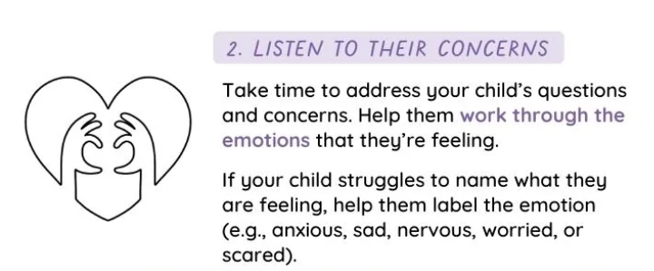

Slide 8
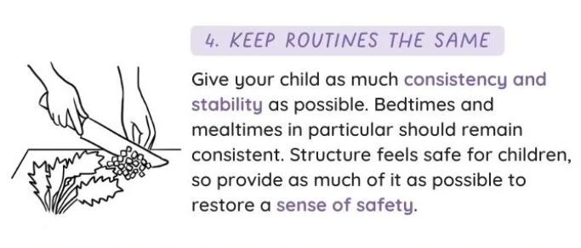

Slide 9
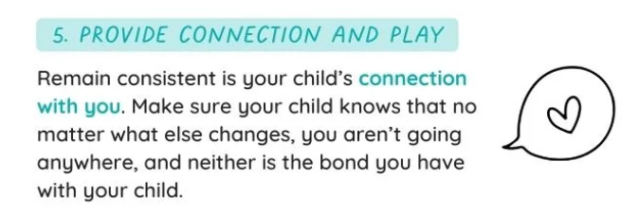

Slide 10
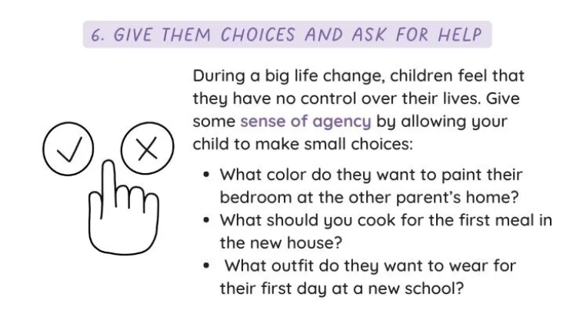

Slide 11
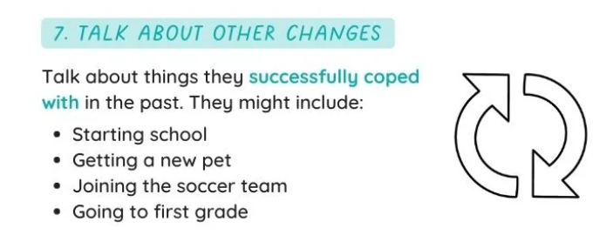

Slide 12
How we prepare children for change
at
Spring Gardens Primary

Slide 13
Pre school-
visits from staff to nursery/home
parent meeting
translation visits into class
visit to have lunch
staff to meet other staff to discuss needs/meeting with SENCO

Slide 14
Moving up to another year group
PSHE lessons about changes
meet new class teacher
have a morning in the new class
passports for children with SEND
transition meetings between staff
SENCO / Care, Guidance and Support Lead advice and guidance for staff
Careful consideration-class lists

Slide 15
Transitioning to High School
Parent /child visits to look around
transition planning meetings between staff form SGPS and the next school
transition visits to high school
High school staff work with children here
Additional transition for children with SEND

Slide 16
Summer schools
all documents shared/delivered
high school staff attend transition meetings such as EHA reviews in the summer term
SGPS staff complete detailed transition forms
Dyslexia team / LCT/EP can support the child
SENCO ensures all paperwork is transferred

Slide 17
How to get your child ready for school: top tips
Encourage your child to explore new environments, activities and interact with new people.
Reassure your child that it’s OK to make mistakes, and encourage them to stay interested in practical activities to develop their concentration skills.
Help develop your child’s communication skills by playing, talking, singing and reading regularly with them.
By the time your child starts school, it is helpful if they are, whenever possible, toilet trained and able to wipe themselves
Encourage your childpossible with t wiping themselves, flushing the toilet and washing their hands with adult supervision.
Provide opportunities for your child to play with other children to support their emotional development.
Ensure that your child has a good routine when it comes to bedtime. A good night’s sleep will help your child cope with the demands of the school day.
Encourage your child to be as independent as possible by practising dressing and undressing themselves. Elastic waistbands and Velcro shoes can help build your child’s confidence with these tasks. At school, your child will need to be able to dress and undress for PE.
Support your child to try new foods, eat at the table using a knife fork and spoon, and use an open cup to drink from.
Encourage your child to tidy and look after their belongings at home. Your child will be expected to hang their coat on their peg and tidy the activities away that they have been playing with in the classroom.
Children need praise and encouragement with general day-to-day tasks, especially when they have achieved new goals such as eating their vegetables or putting their toys away. Praise encourages positive self-esteem and self-worth.
The more your child practices these skills, the more their confidence will grow.

Slide 18
Provide opportunities for your child to play with other children to support their emotional development.
Ensure that your child has a good routine when it comes to bedtime. A good night’s sleep will help your child cope with the demands of the school day.
Encourage your child to be as independent as possible by practising dressing and undressing themselves. Elastic waistbands and Velcro shoes can help build your child’s confidence with these tasks. At school, your child will need to be able to dress and undress for PE.
Support your child to try new foods, eat at the table using a knife fork and spoon, and use an open cup to drink from.
Encourage your child to tidy and look after their belongings at home. Your child will be expected to hang their coat on their peg and tidy the activities away that they have been playing with in the classroom.
Children need praise and encouragement with general day-to-day tasks, especially when they have achieved new goals such as eating their vegetables or putting their toys away. Praise encourages positive self-esteem and self-worth.
The more your child practices these skills, the more their confidence will grow.

Slide 19
Support your child to try new foods, eat at the table using a knife fork and spoon, and use an open cup to drink from.
Encourage your child to tidy and look after their belongings at home. Your child will be expected to hang their coat on their peg and tidy the activities away that they have been playing with in the classroom.
Children need praise and encouragement with general day-to-day tasks, especially when they have achieved new goals such as eating their vegetables or putting their toys away. Praise encourages positive self-esteem and self-worth.
The more your child practices these skills, the more their confidence will grow.

Slide 20
Helping your child with worries and anxiety

Slide 21
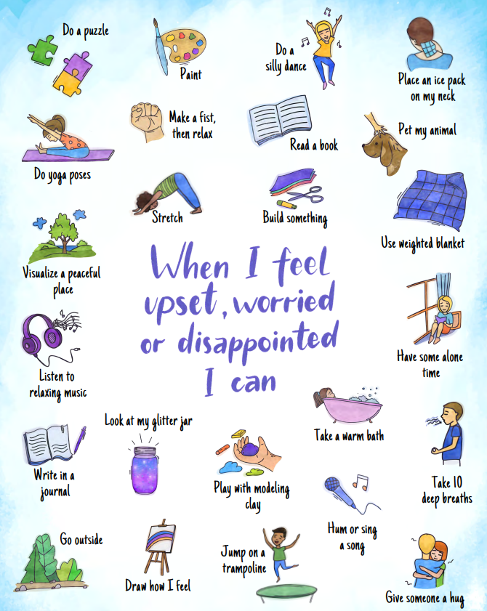

Slide 22
Practise the school run
Talk positively about school
get involved
visual timetable
practise school morning routine-getting up, dressed, breakfast-to help with time management
Trial run in school holidays
Night before get uniform and bag ready

Slide 23
Be your child’s anchor
https://youtu.be/cjGjUW9rtJk

Slide 25
We are now going to watch an animation that shows four pupils starting secondary school.
As you watch, think about the problem each character has and how they solve them.

Slide 26
https://youtu.be/thnoUraeoGs
Watch online

Slide 27
What were the characters worried about before they started secondary school?
Why were they worried?

Slide 29
How did Albie, Alisha, Dele and Eliza solve their problems?

Slide 31
It’s important to think about self-care, as self-care can help us to feel better if we’re feeling down, and can help keep us feeling good.
It’s a great way to look after our own mental health and wellbeing.

Slide 33
Why is it good to tell someone when you are worried about something?
Who could you speak to in school if you are worried?

Slide 35
In school you can talk to…
[Insert support options at your school]

Slide 36
Other places
On My Mind – www.annafreud.org/on-my-mind/
Youth Wellbeing Directory – www.annafreud.org/on-my-mind/youth-wellbeing/
Self Care pages - https://www.annafreud.org/on-my-mind/self-care/
Urgent Help – https://www.annafreud.org/on-my-mind/urgent-help/
Anna Freud Centre – www.annafreud.org/
[Optional: insert any other organisations in your local area where young people can find support]

