Slide 1
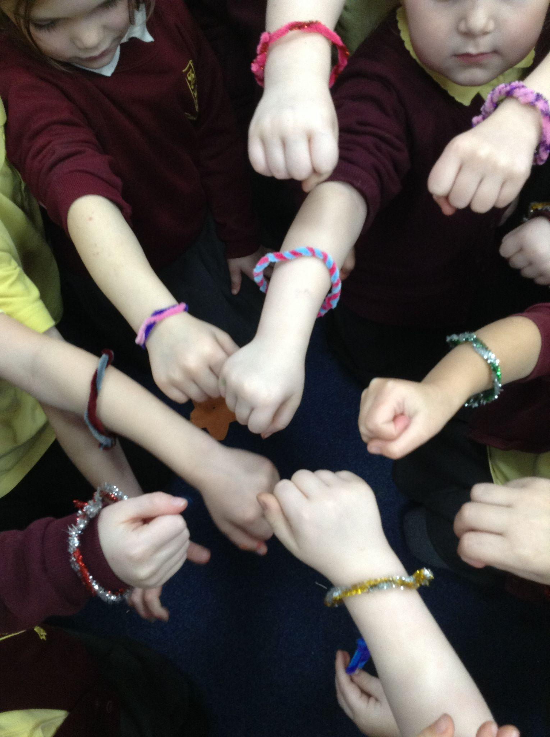
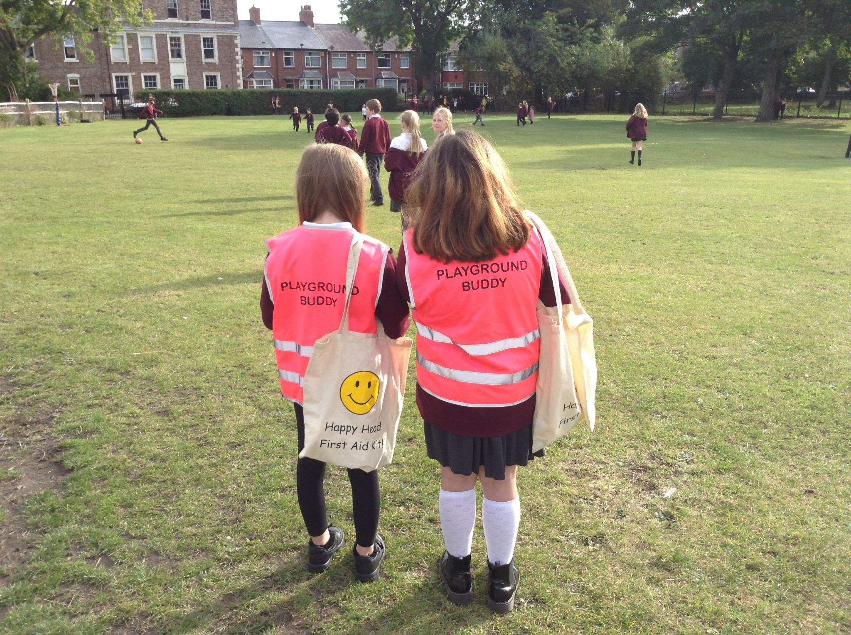
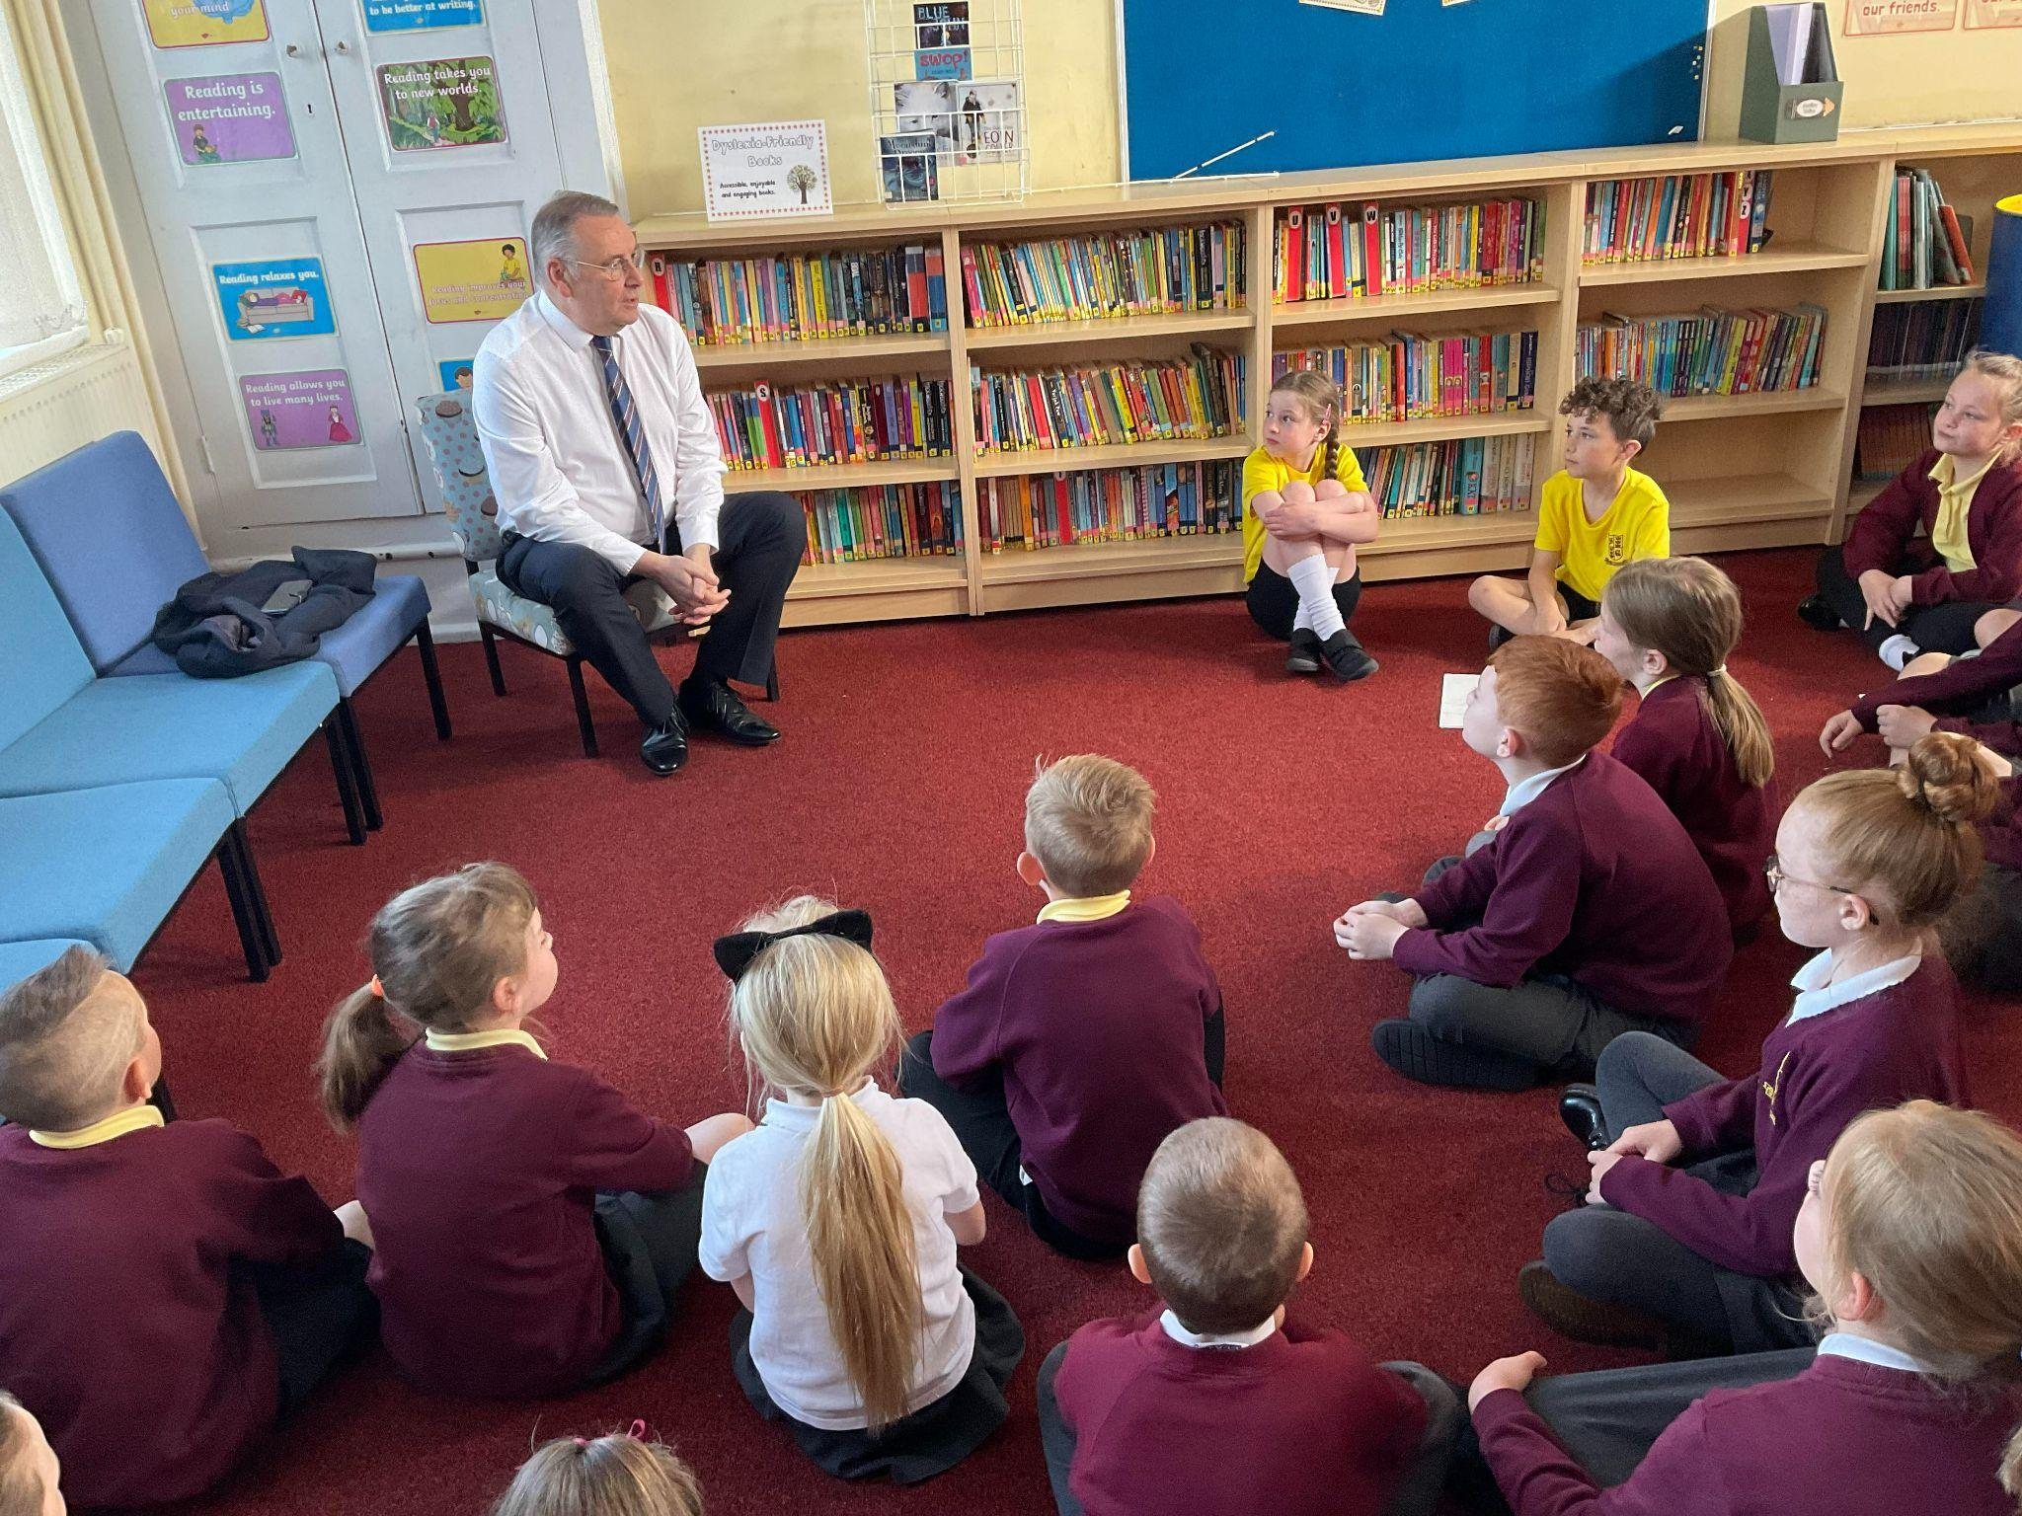
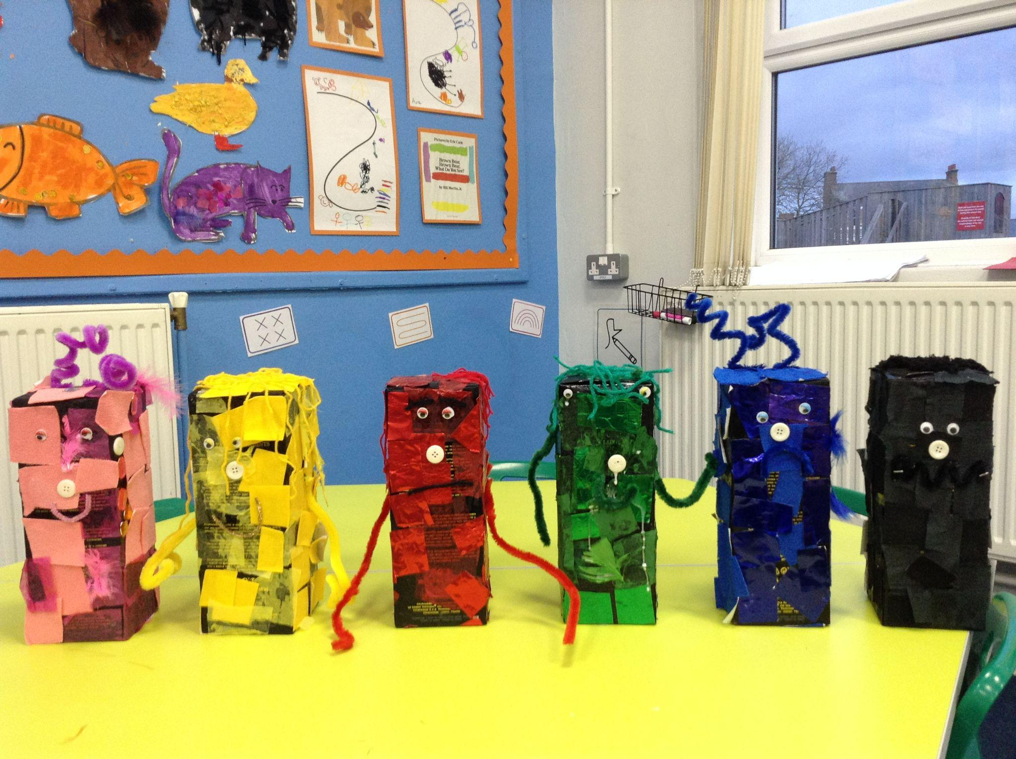
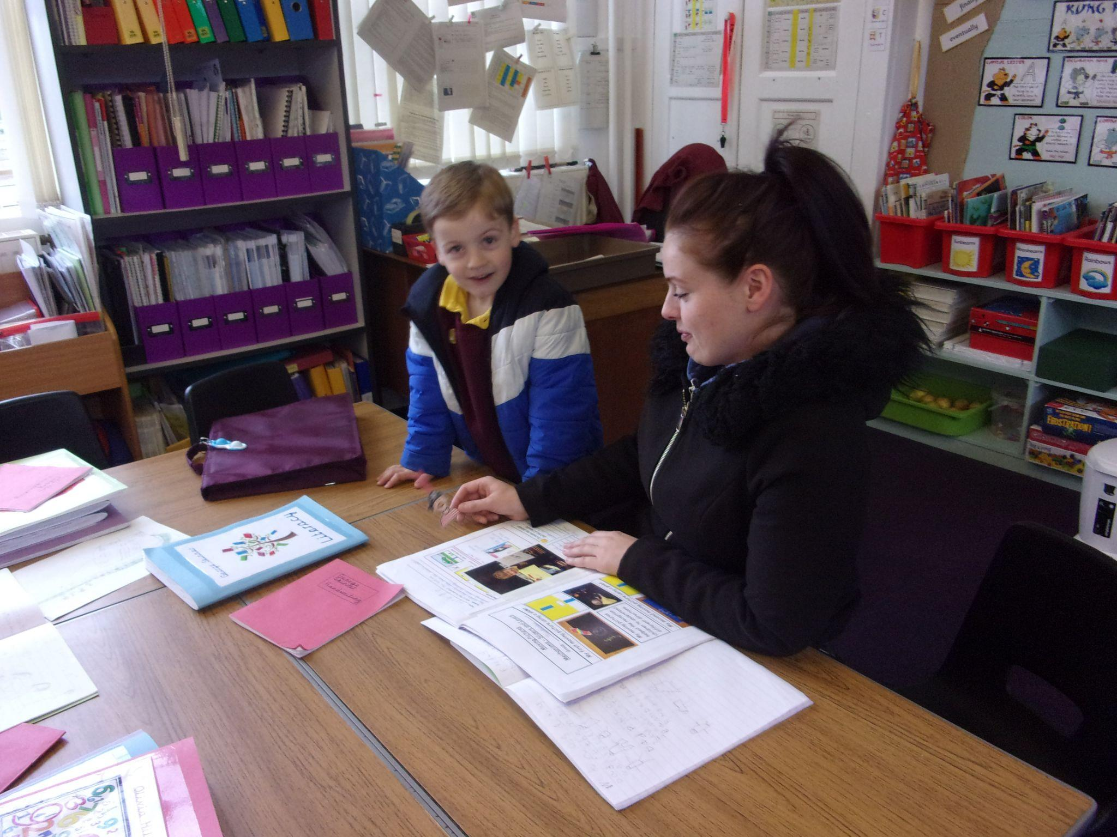
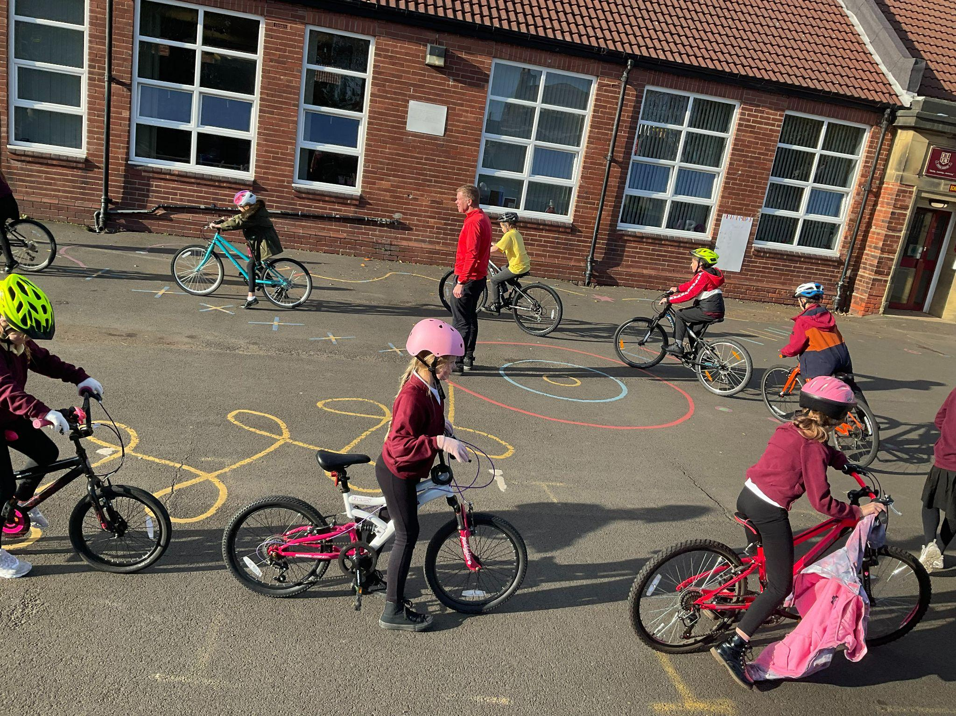
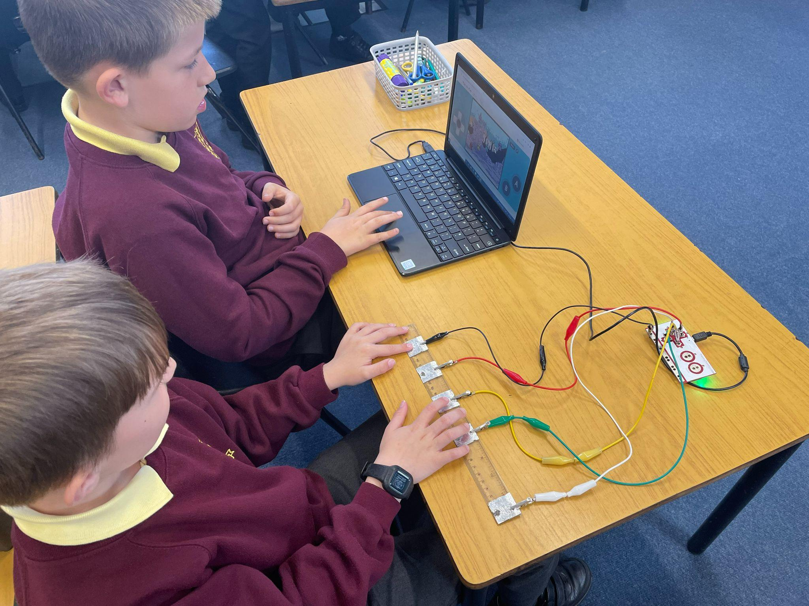
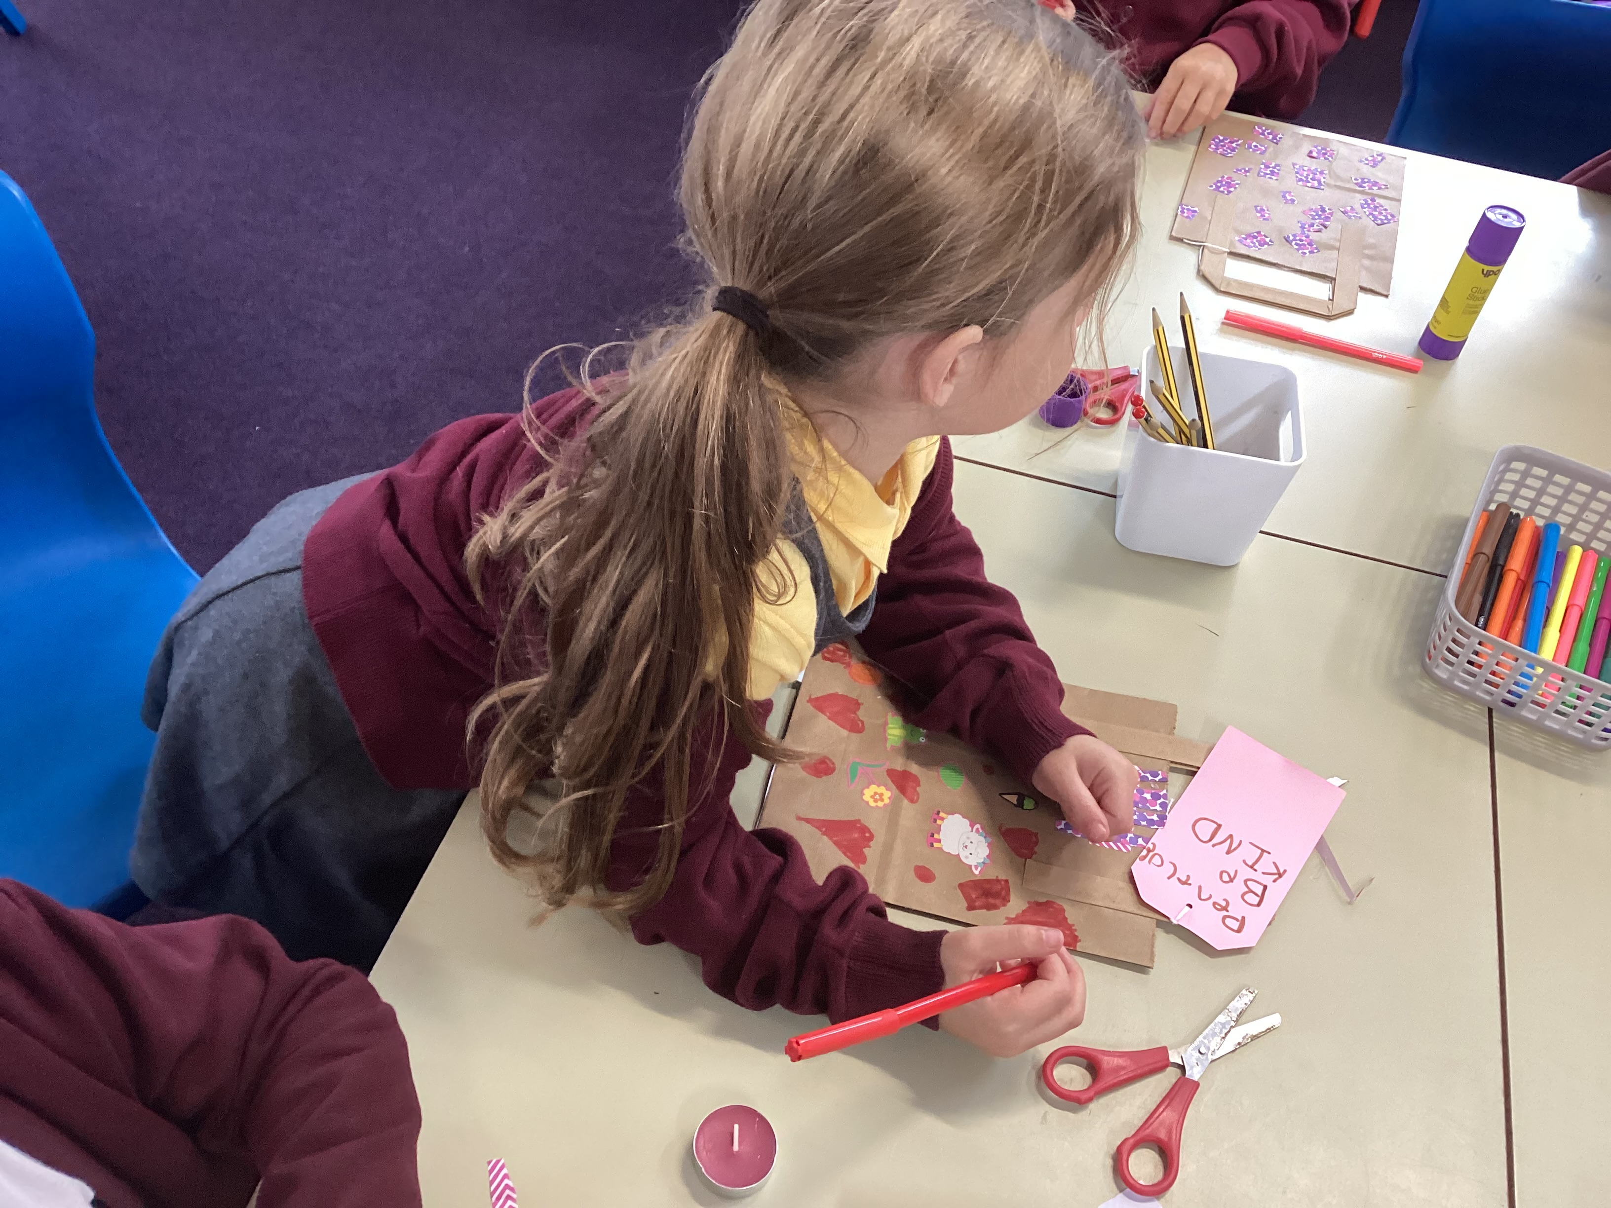
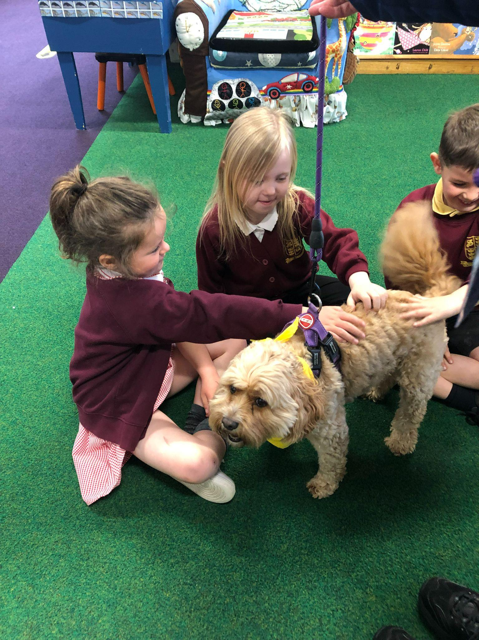
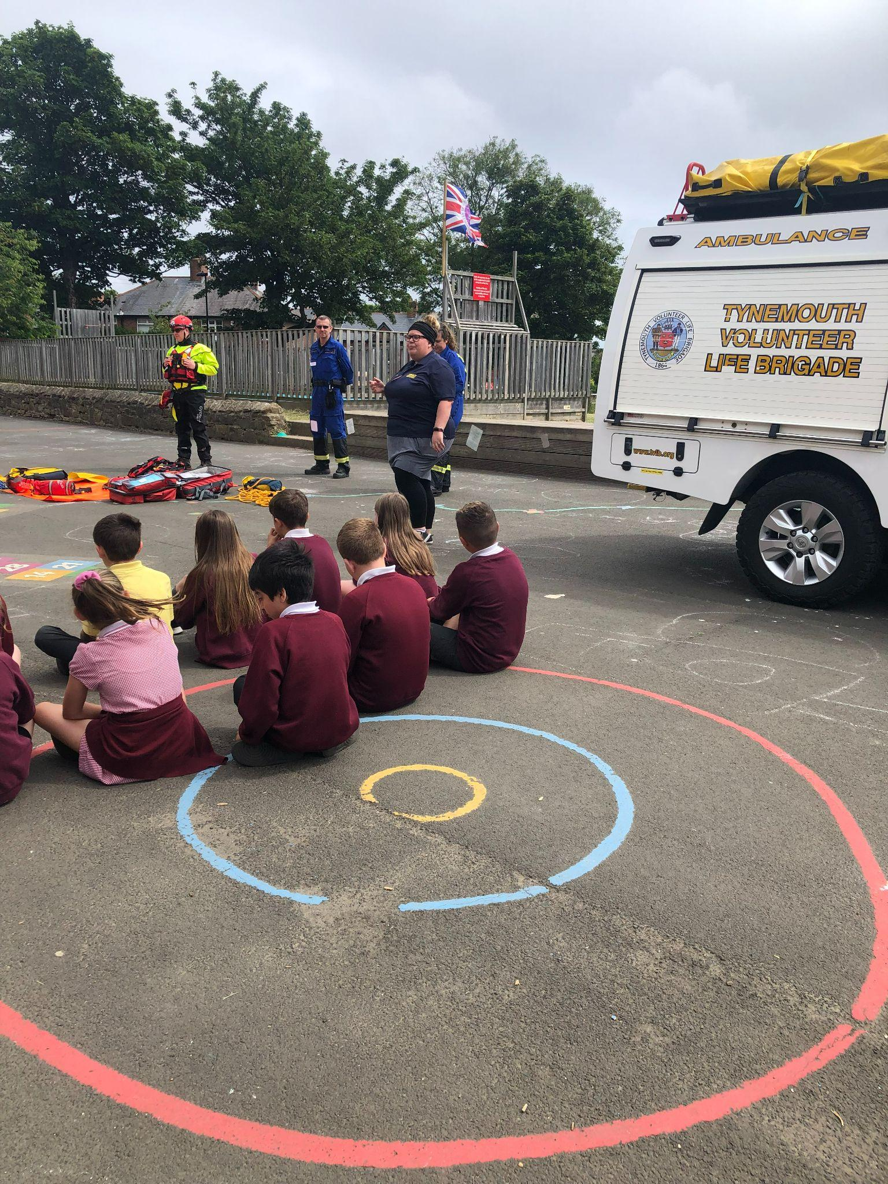
Parent Transition Meetings
2025-26

Slide 2
Transition meetings for parents/carers
Year 1 and 2
2025-26

Slide 3
Year 1 and 2 will work slightly differently moving forward…
There will be 3 mixed year 1 / 2 classes.
The children will start the day in their registration class.
They will then move to one of the 3 classes for the morning, where they will have their phonics, literacy and maths lessons.
In the afternoon they will come in from lunchtime and return to their registration class where they will be taught the foundation subjects.
This enables school to ensure that the children are getting the best provision possible.
Notes:
Other Year groups to remove this slide

Slide 4
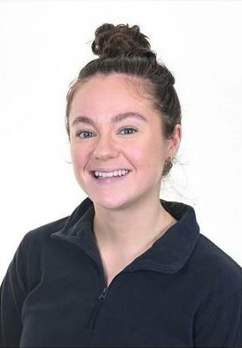
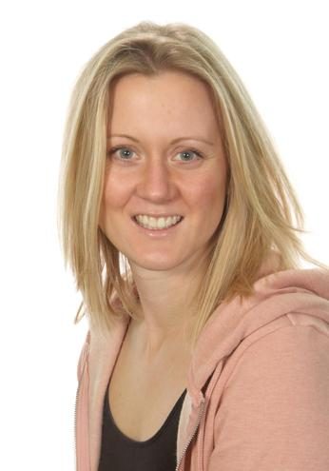
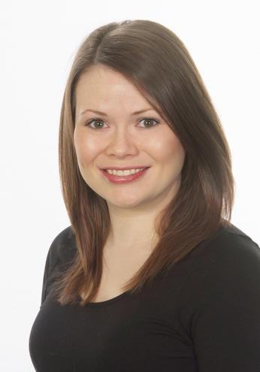
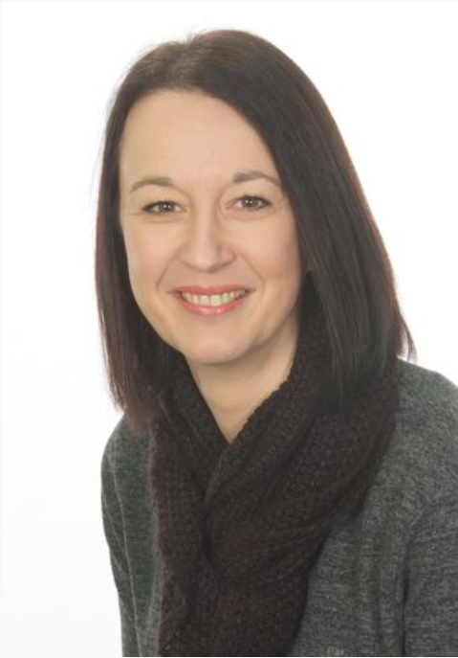
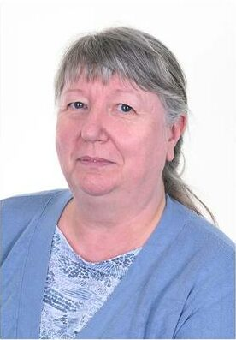
The staff for Year 1/2
Class 5
Miss Jack
Class 3
Mrs Chambers & Mrs May
Class 4
Mrs Styles & Mrs Young
Notes:
Other Year groups to remove this slide

Slide 5
Curriculum - Example of a Weekly Timetable

Slide 6
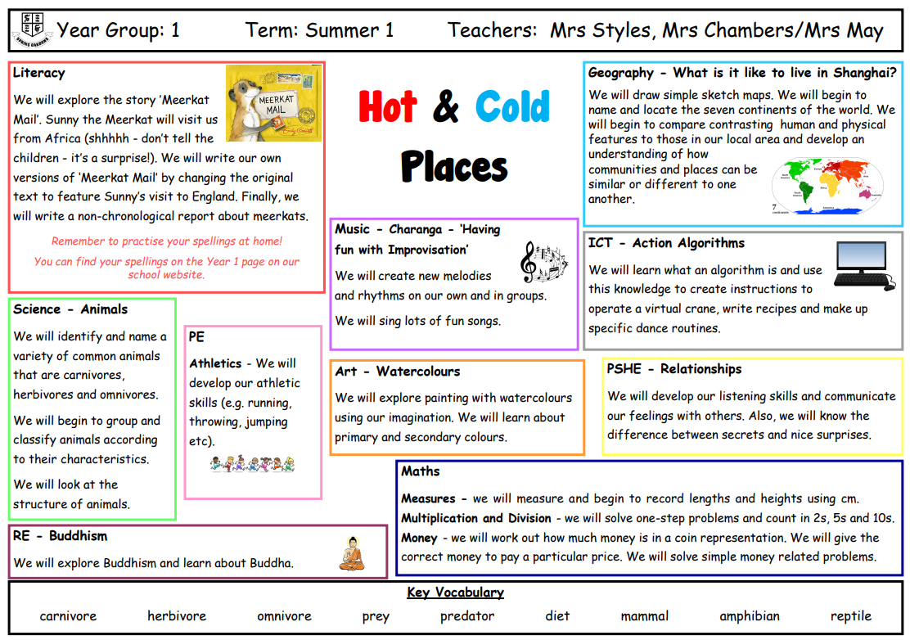
Curriculum - Example of a Curriculum Overview
Autumn Term 1 - Pedestrian Training

Slide 7
Curriculum - Phonics Scheme
Please note - there will be a £5 charge for lost/damaged reading and library books.

Slide 8
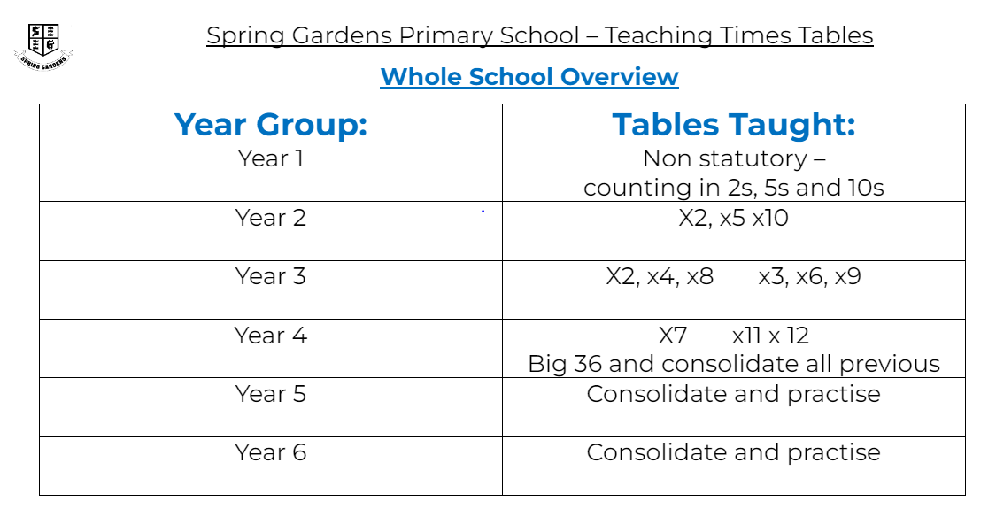
Curriculum - Maths

Slide 9
Curriculum - Homework
Thank you for your support!
School Reading Book
We will aim to read with your child in school at least three times per week. It will be of huge benefit if you listen to them read at home too. We want the children to read and then reread the same book so that they build confidence and fluency.
Spellings
At the beginning of each term spellings will be sent home. Please practise them with your child as this will really help boost their confidence when they are writing independently.

Slide 10
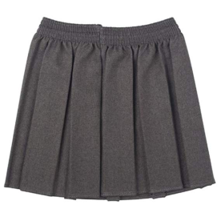
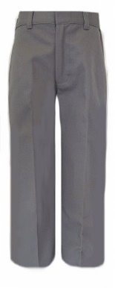
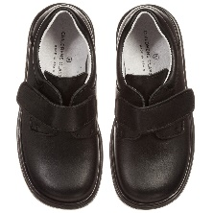
Expectations for next year
Uniform
It is important that your child has the correct uniform to be part of our school community.
Maroon jumper or cardigan (plain maroon sweaters or logo are acceptable)
White or yellow polo shirt or white blouse/shirt (plain or logo)
Trousers - grey (plain) no jeans or denim type. Skirts - grey pinafore or grey skirt
Grey or white socks
Black shoes
Yellow or white polo shirts - do not have to have a logo
Summer Uniform
Pupils can wear a maroon, yellow or pink gingham dress.
Please remember that uniform can be ordered from https://www.michaelsehgal.co.uk/
Notes:
Uniform from Emblematic is still ok - it’s just that we are with a new supplier.
Name all items.
Letter with PE days to be sent out in September - home at end of the week.
Reminder: make-up/nails/nail varnish/jewellery

Slide 11
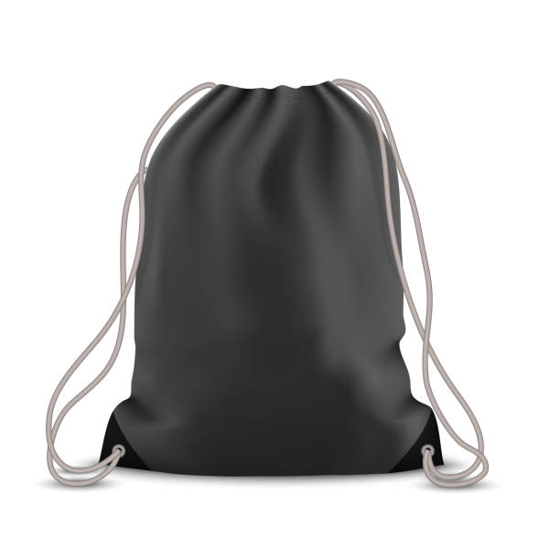
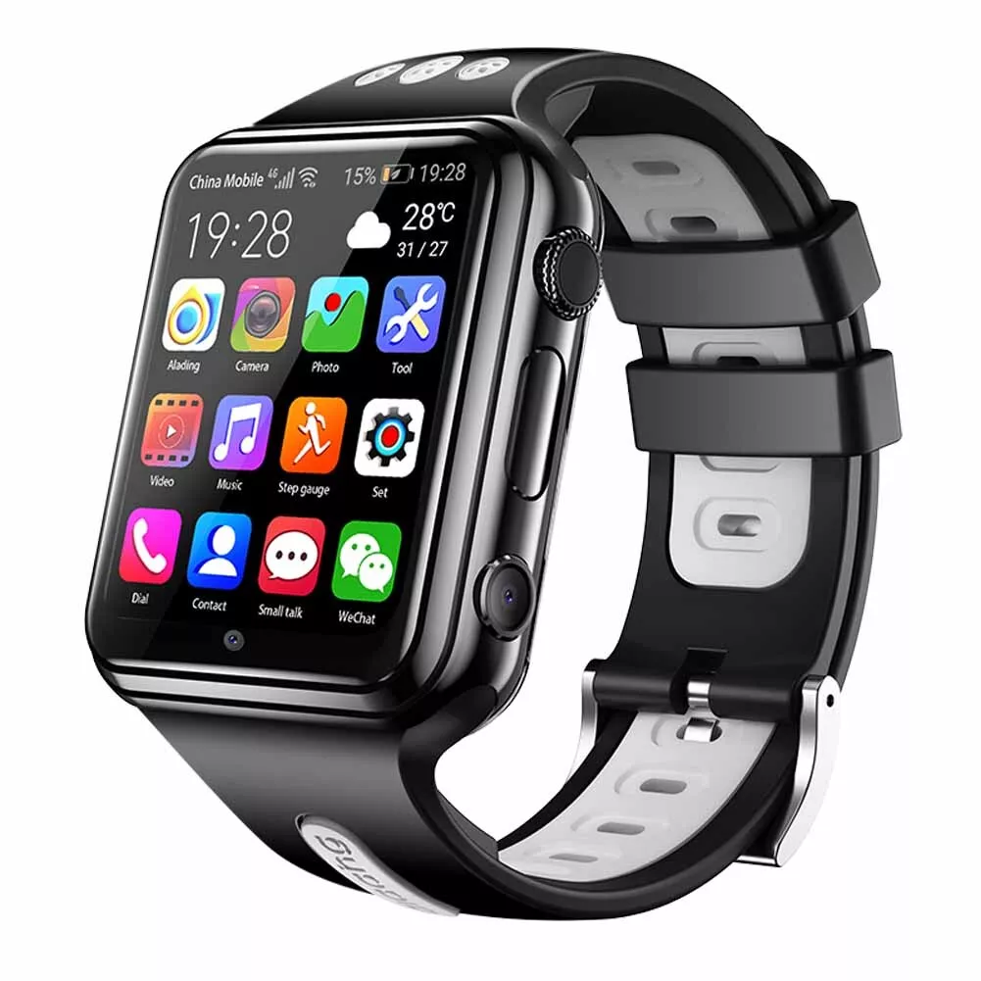
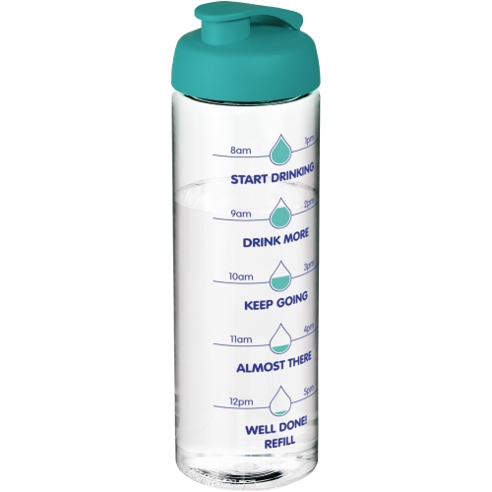
Expectations for next year
Please ensure that your child has a yellow PE top, black shorts and trainers in a named drawstring bag that they can keep on their peg.
Smart Watches are not allowed to be worn in school
Earrings – Only ONE STUD earring in each ear. If your child has their ears pierced it is important that they can take them out on their own for PE. If they can’t, it is important that they are removed before school on the days they have PE. Please wait until the summer holidays to get ears pierced.
Water Bottles - Please send your child to school with a clear bottle every day so that they can fill it with water.

Slide 12
Please name your child’s belongings!
It’s very hard to reunite lost uniform when they’re all the same size/style!

Slide 13
Attendance
As a school, Spring Gardens recognises the importance of high attendance.
Whilst there are many reasons that children may be out of school it is imperative that children attend to ensure they are able to progress and retain the learning.
No holidays in term time will be authorised.
The school MUST be notified for any absence using the leave of absence form.
Notes:
Dates for SATs week (08.05.23-11.05.23) and lead up.
Breakfast club
Anxiety - strategies
Self-care: importance of sleep/managing/limiting devices

Slide 14
School Lunches
Your child may choose to have a school dinner or bring their own packed lunch
All children eat in the dinner hall except during the summer term and the weather permits packed lunches to be eaten outside if they choose
As we have children with allergies in school, NO NUT BASED PRODUCTS should be included in packed lunches. If a child is known to have a nut based product this will be removed from their packed lunch and given to the adult collecting at the end of the day
School lunches are provided by Hutchison Catering and must be ordered in advance
https://appetite.hutchisoncatering.co.uk/
Payment for lunches needs to be done through their system
Please note, the cost of a school dinner will be increasing to £2.55 from September
Menus can be found on our school website - https://www.springgardensprimary.org.uk/lunch-menus/
For more information - https://my.northtyneside.gov.uk/category/238/free-school-meals

Slide 15
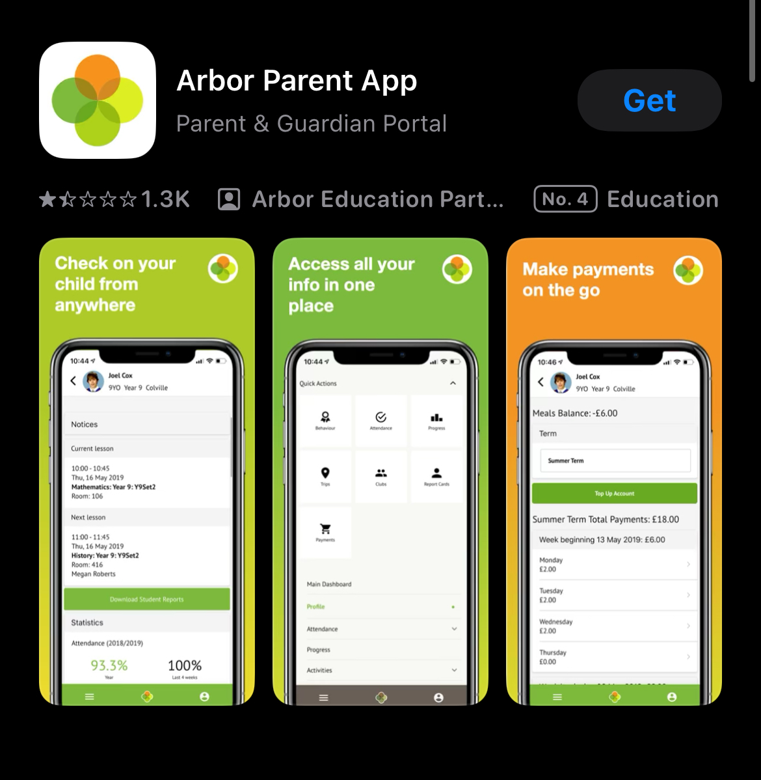
Communication, payments, booking and permissions
We ask that parents/carers download the Arbor Parent App as this will be used for communication, payments, bookings and permission requests
This will take away the need for multiple systems of communication
Parents will also be able to use this to change their contact details and view their child’s up to date attendance

Slide 16
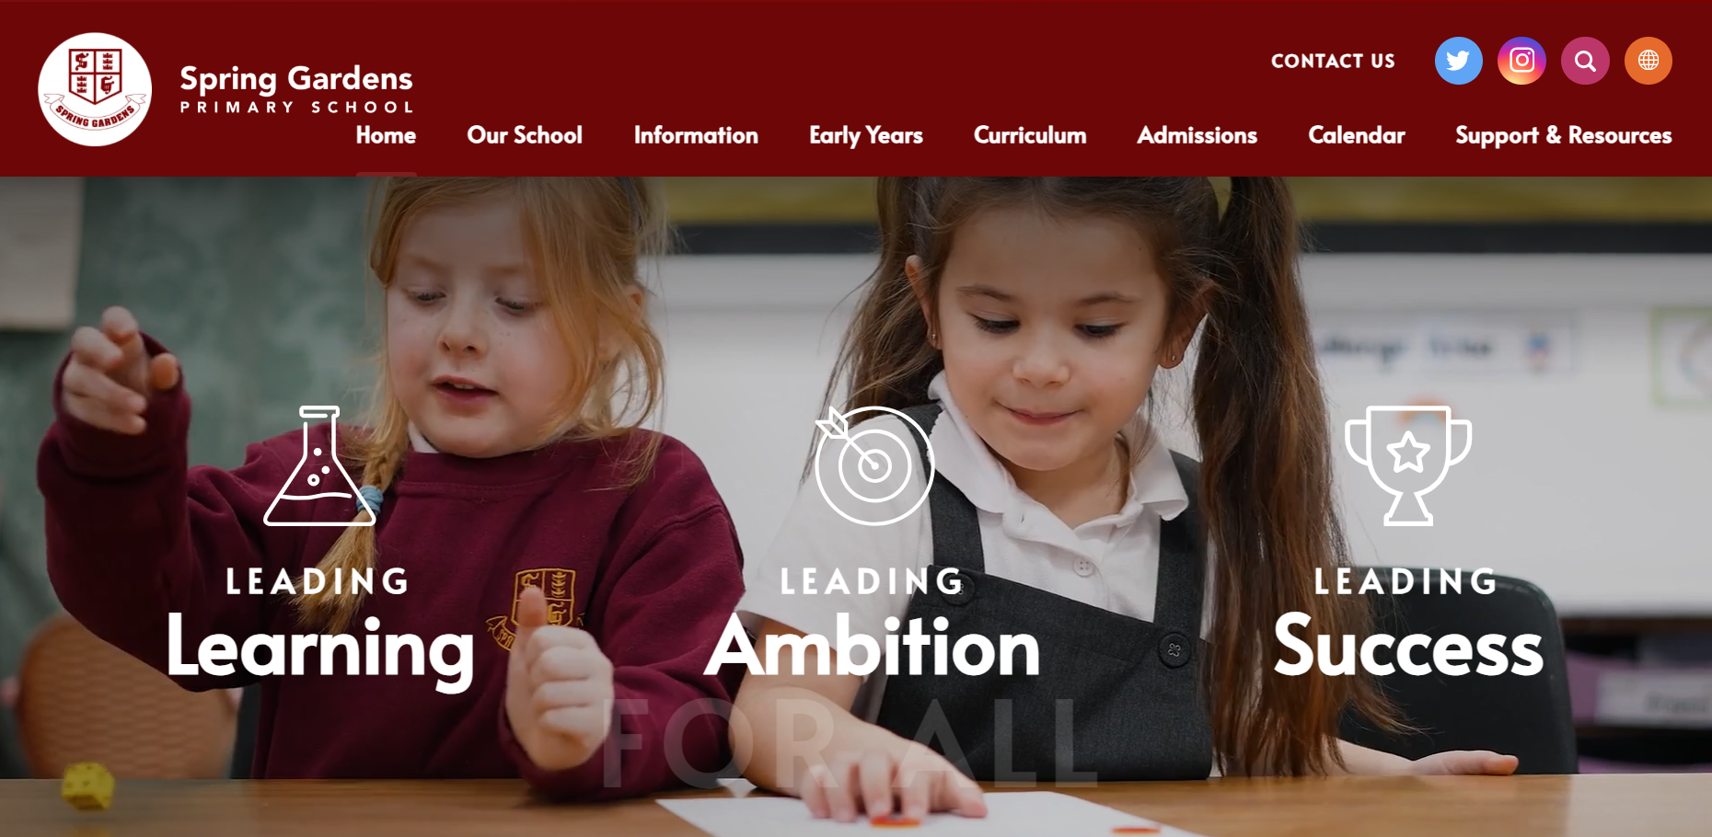
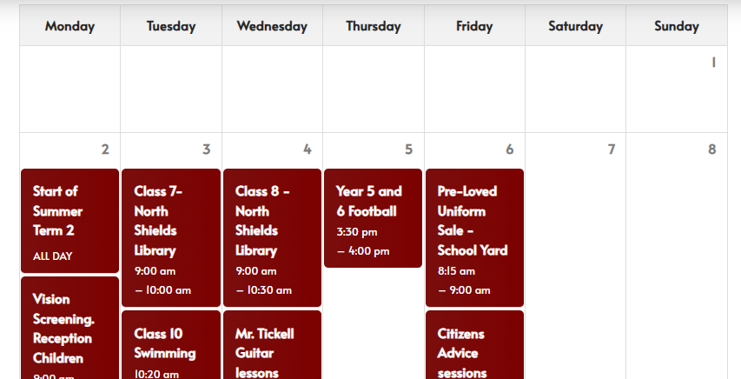
Communication, payments, booking and permissions
The school website is a great resource from the calendar for keeping on top of school events to links for supporting your child online
Keep up to date with what’s happening in school on social media through Instagram and Facebook

Slide 17
The School Day
The start to the school day;
Breakfast club starts at 8:00am. No child should be onsite unaccompanied before this time – The school gates will only be open just before 8:00am
Parents/carers must pre-book children onto breakfast club - information can be found on the school website - Wrap Around Care - Spring Gardens Primary School - North Shields
Staff on yard - 8:45am
Children enter the building - 8:50am
Gates locked - 8:55am
Please make sure your child is in the line to come in with their class at 8:50am so they have a calm and controlled start to their day
End of day - 3:20pm (Year 1 - 6)
Notes:
We are very lucky to still be able to provide a breakfast club for children. They enjoy time with their friends and get breakfast so they are fuelled for the day.
We are always here to support your child’s learning: staff are on the yard if you need to mention/ask anything before the start of the school day or you can ring/email the school office if you require to speak to us at greater length.
Children need to be prepared for the school day: school bags need to be brought to school every day with their reading books within.

Slide 18
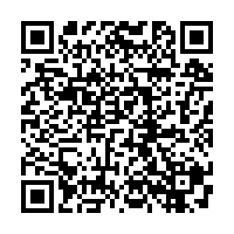
Collection Policy
Our school collection policy can be viewed here
Parents/carers must note that up to year 5, all children must be collected by a trusted adult or sibling who is in Secondary school.
Siblings in year 5 or 6 are not able to collect and be responsible for younger siblings. Parents/carers must inform school if someone other than the normal adult is collecting by either telling the class teacher, emailing or phoning the school office.
If there is any doubt, school staff will not let the child leave our care until contact has been made with the child’s parent/carer to confirm the arrangement.

Slide 19
The School Day
We are making some changes to the way the older children come into and leave the building at the start and end of the day.
From September;
Year 5 and 6 will line up on the KS 1 yard next to year 3/4
Year 5 and 6 will come into the building through the current Year 3/4 doors and the year 3 / 4 children will enter through the doors with the ramp.
The children will also leave through these doors.
This has all been explained to the children during their move up morning.

Slide 20
Home-School Agreement
We recently sent home with your child a copy of our Home – School Agreement. If you haven’t done so already, please read through with your child and sign and return to school.
We believe this to be an important agreement as it not only sets out what school requests from parents/carers but also what you can expect from school.

Slide 21
Any questions?

