Slide 1
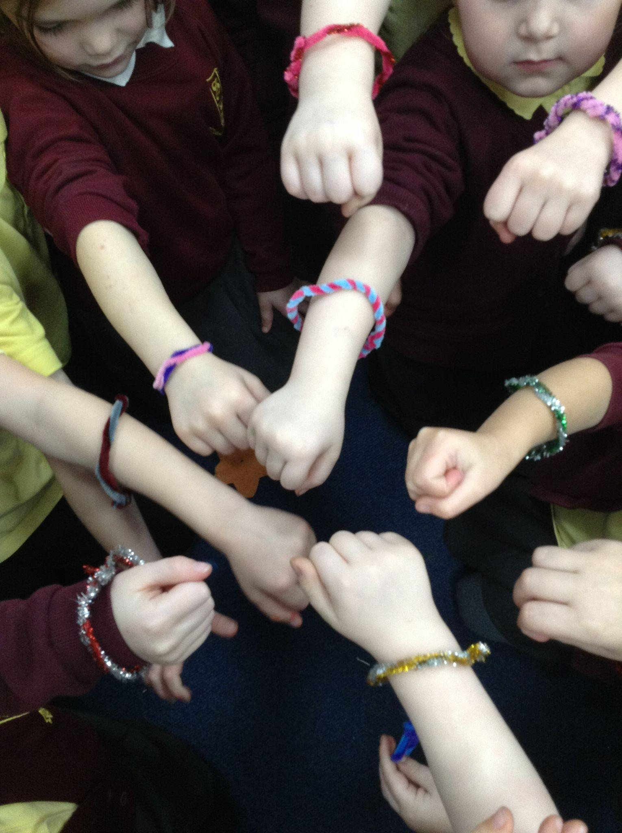
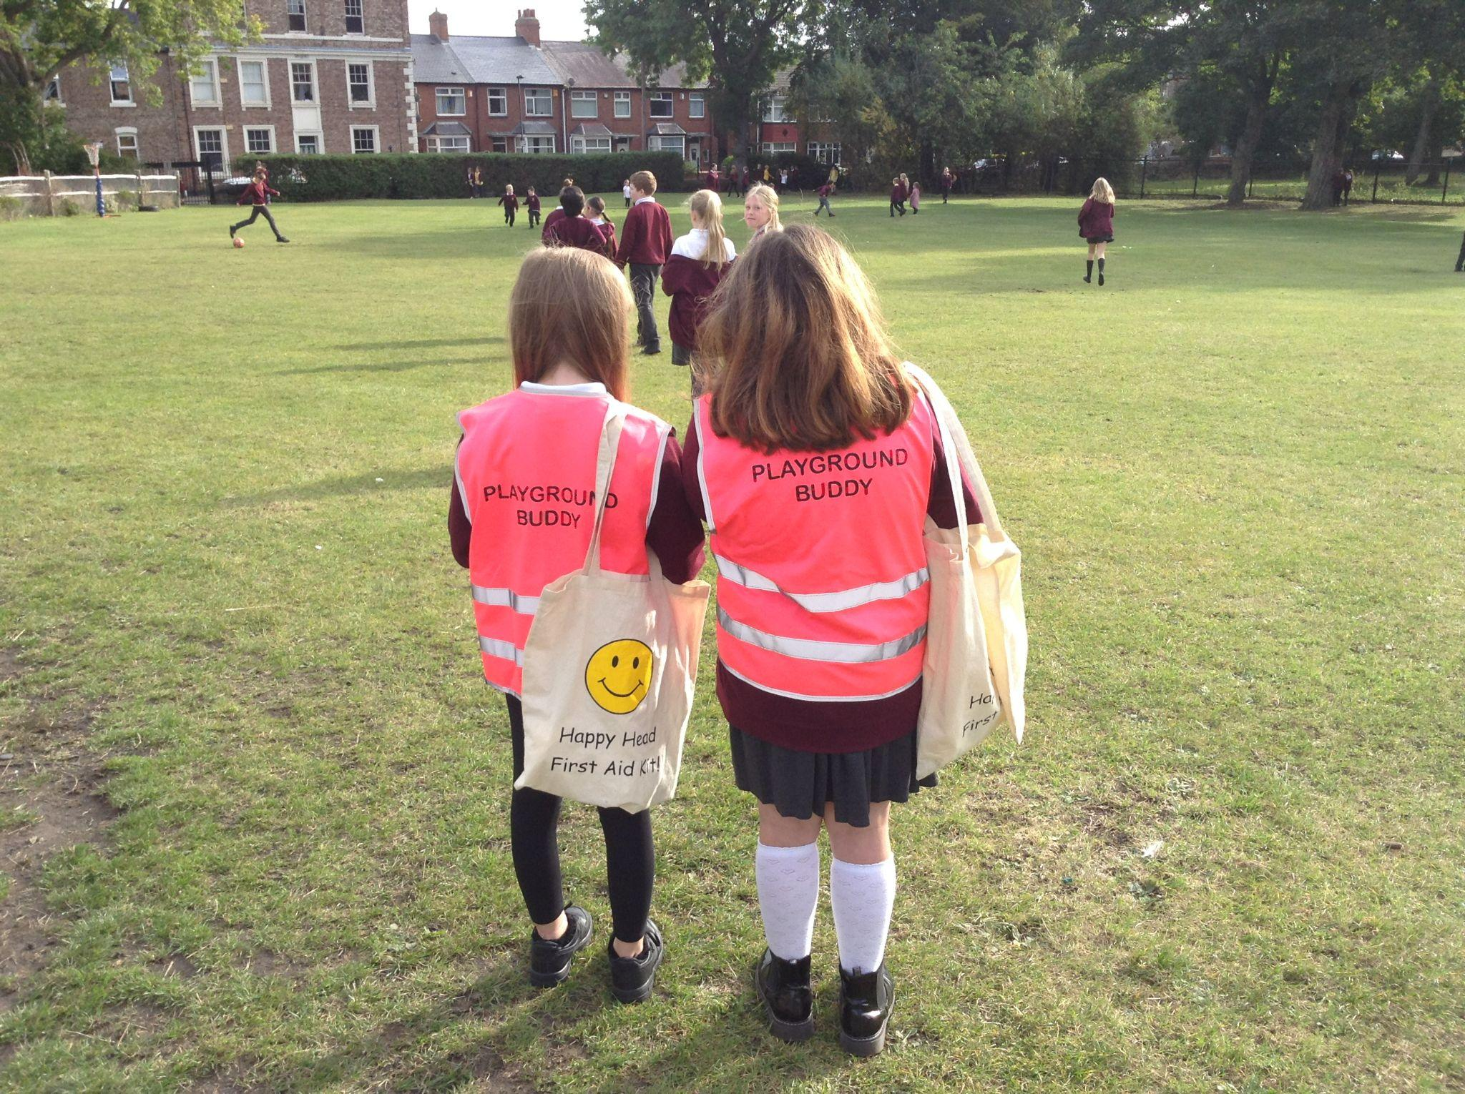
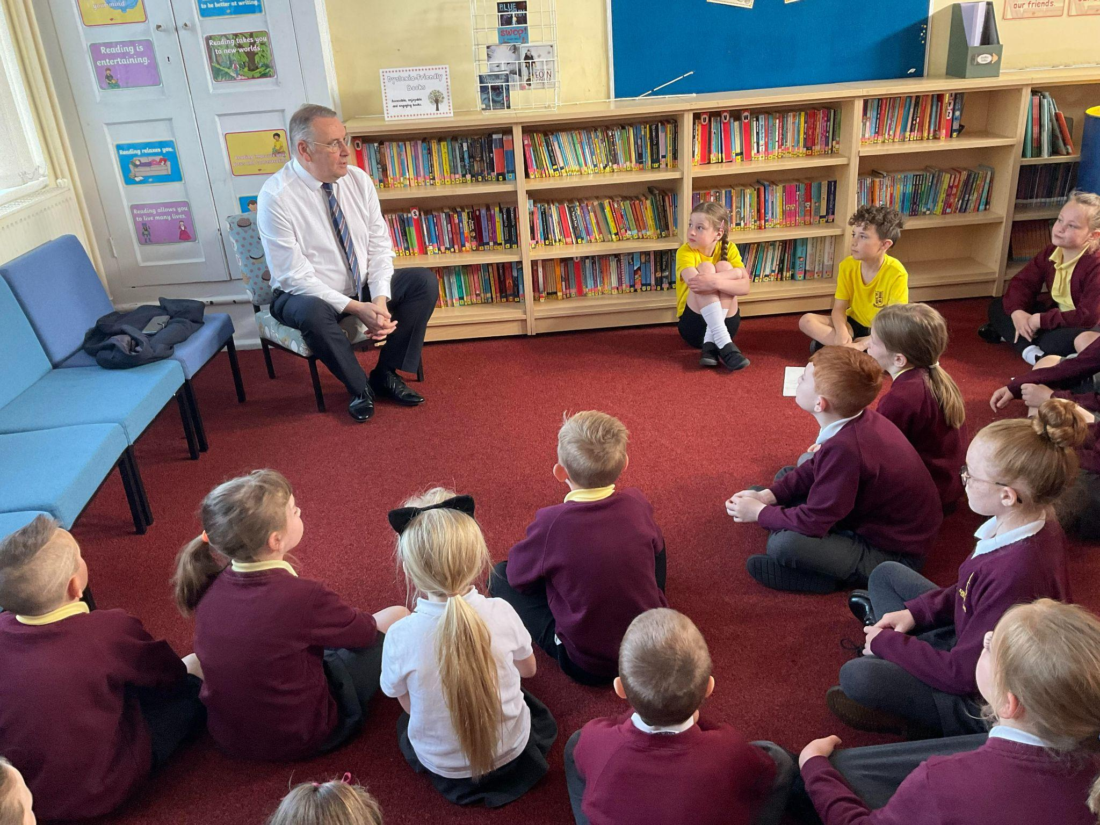
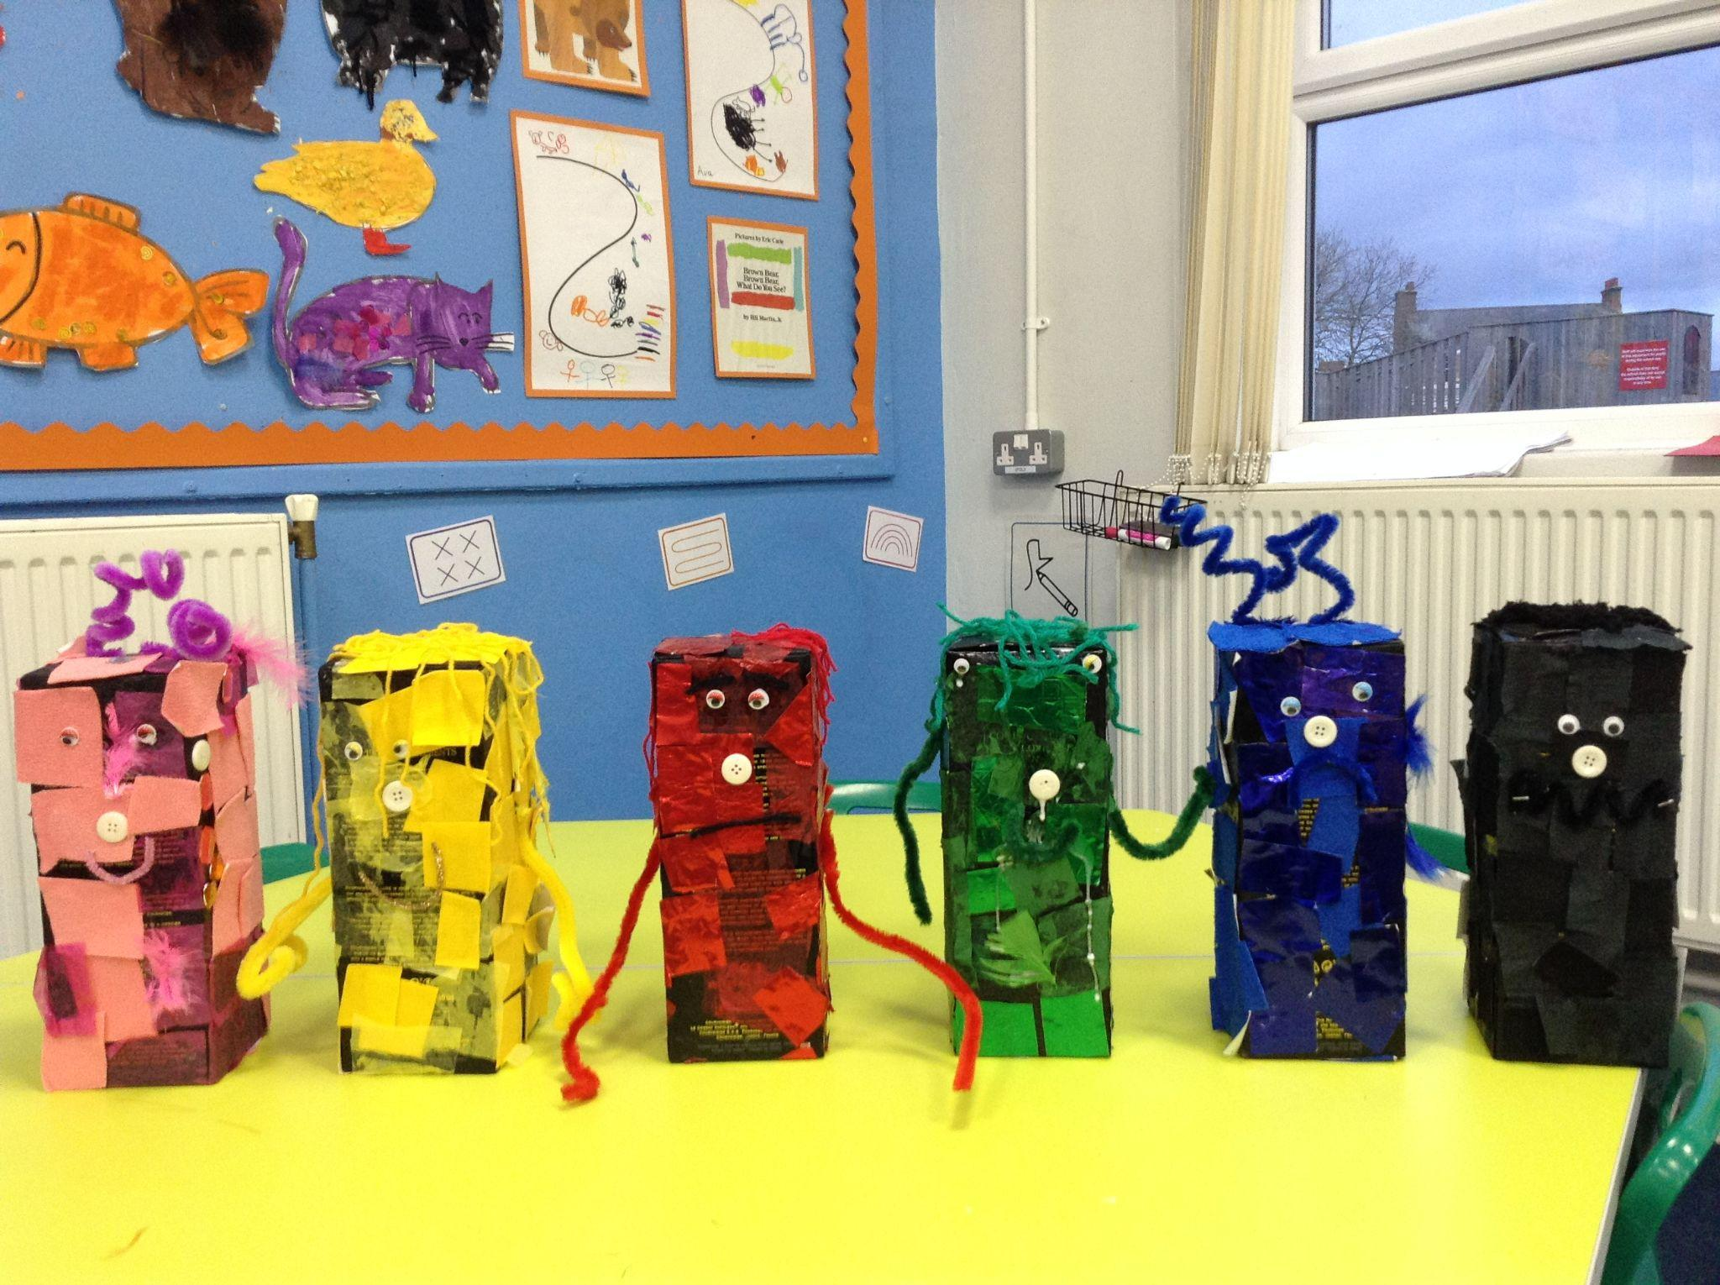
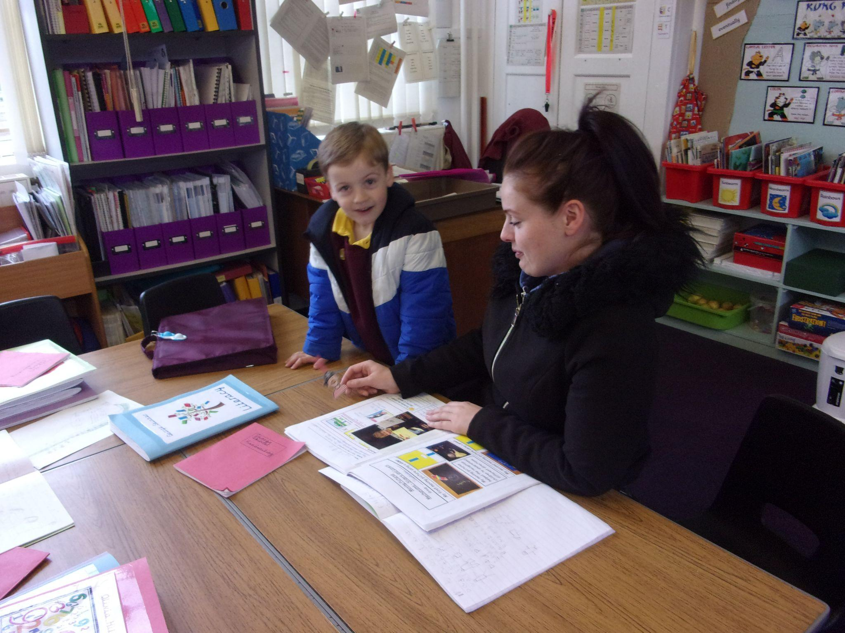
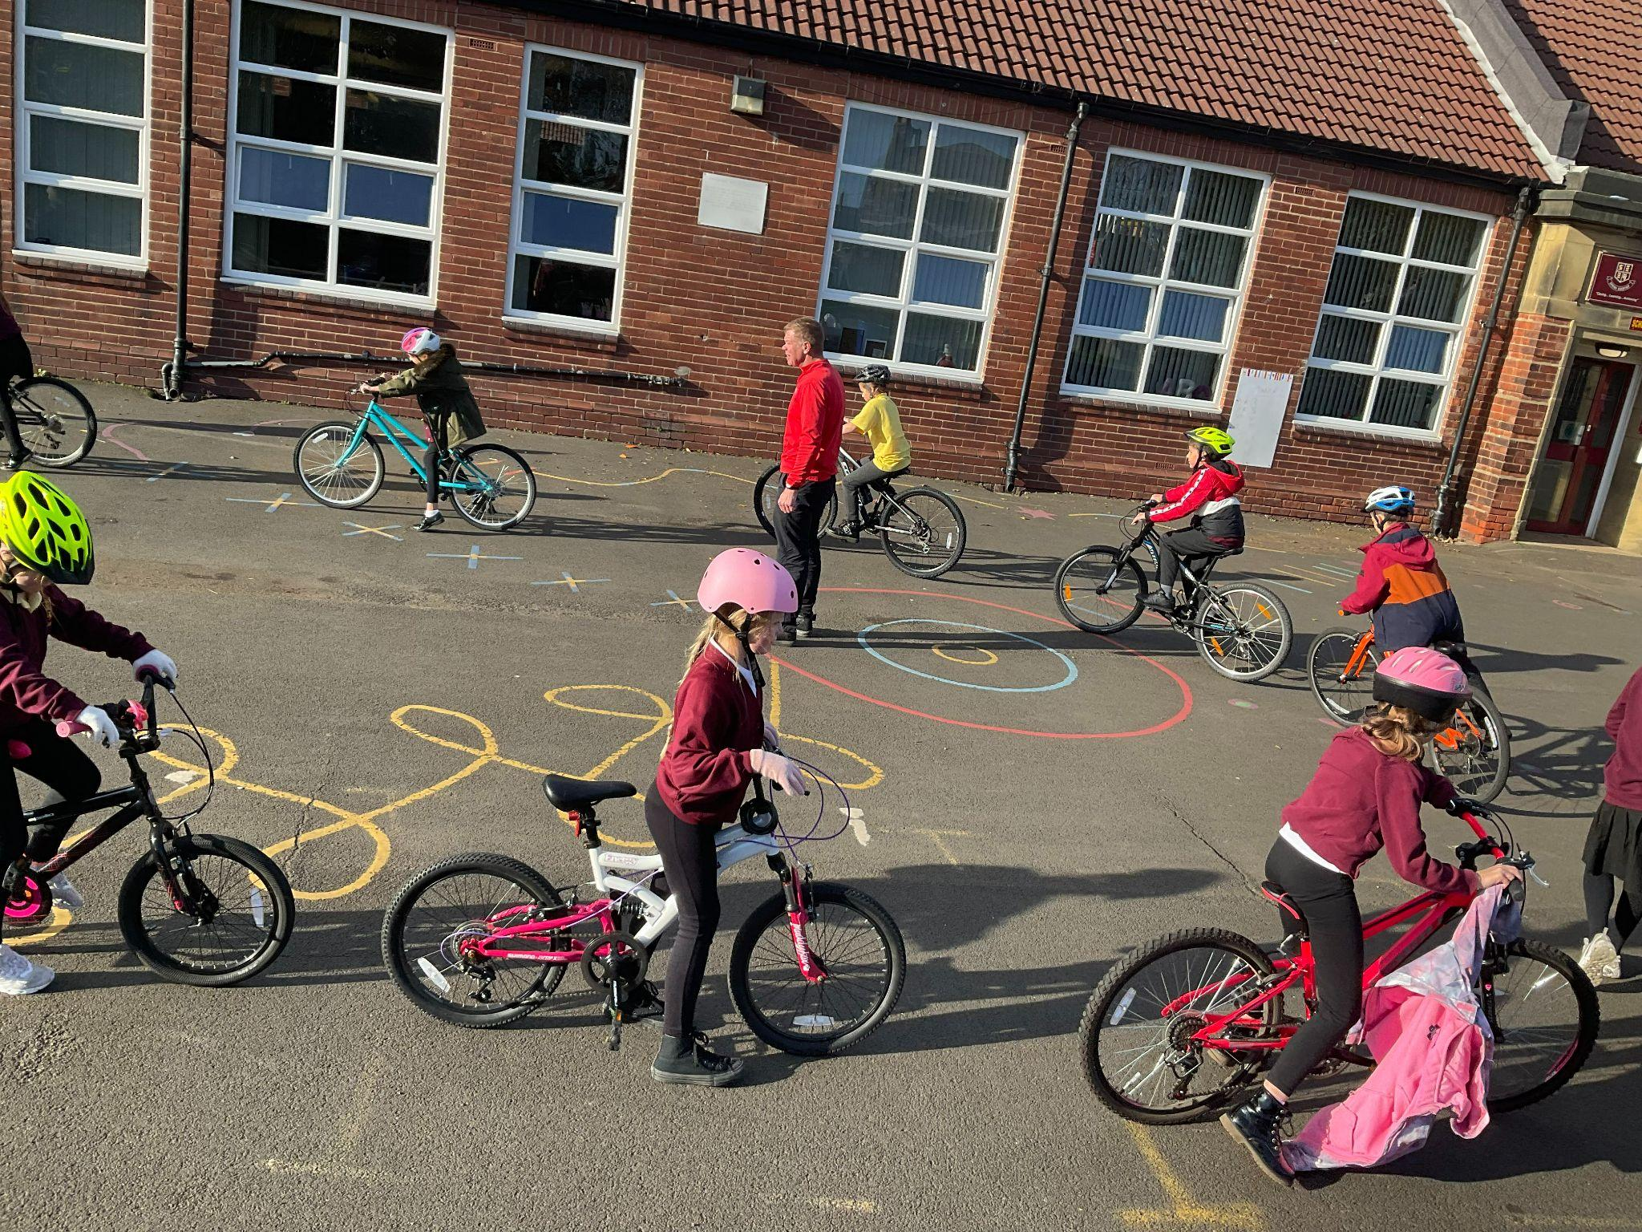
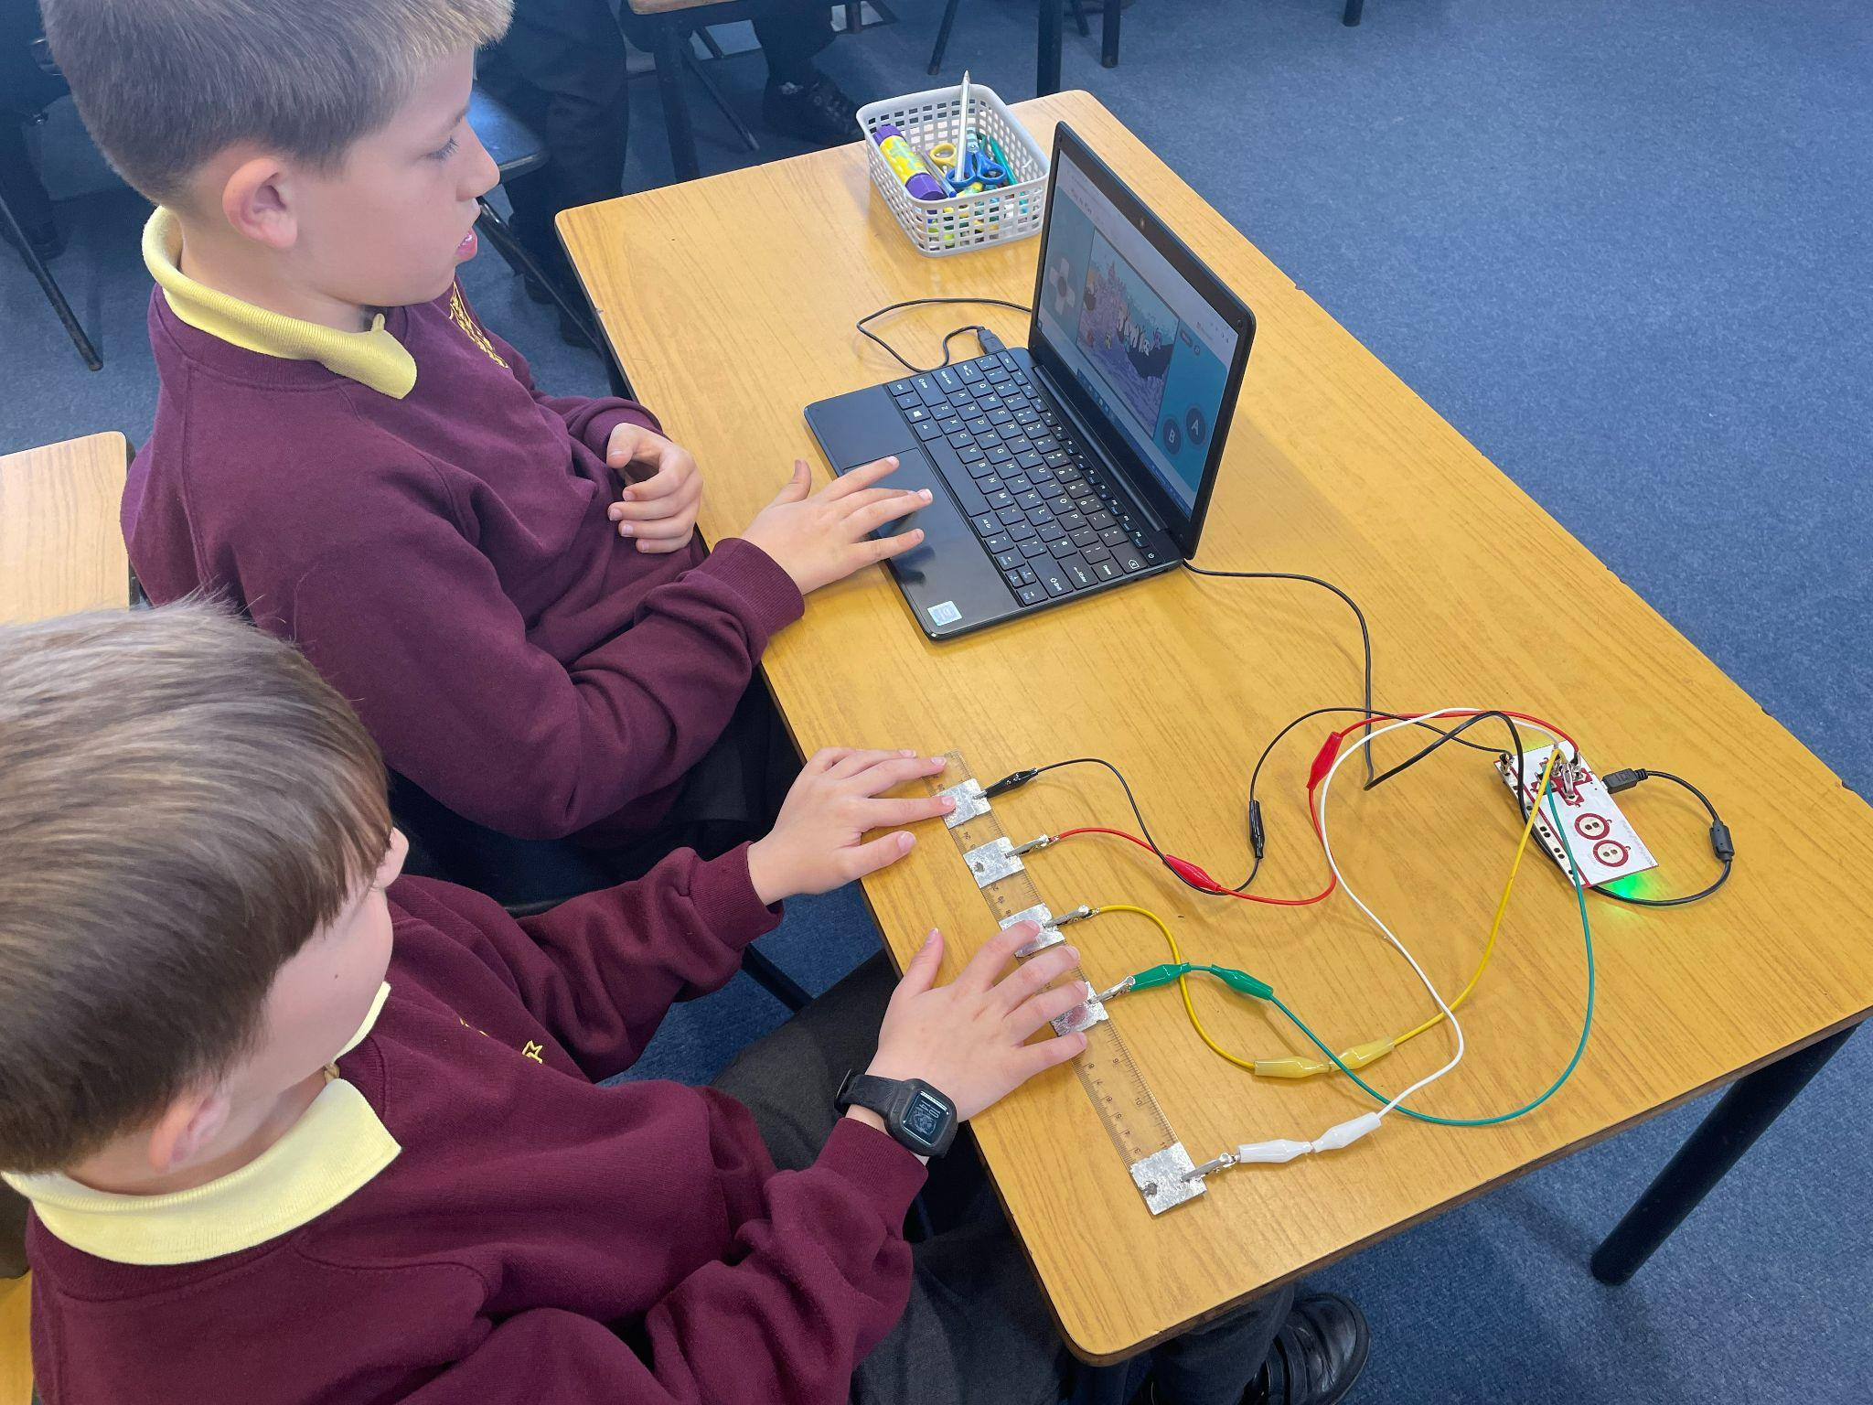
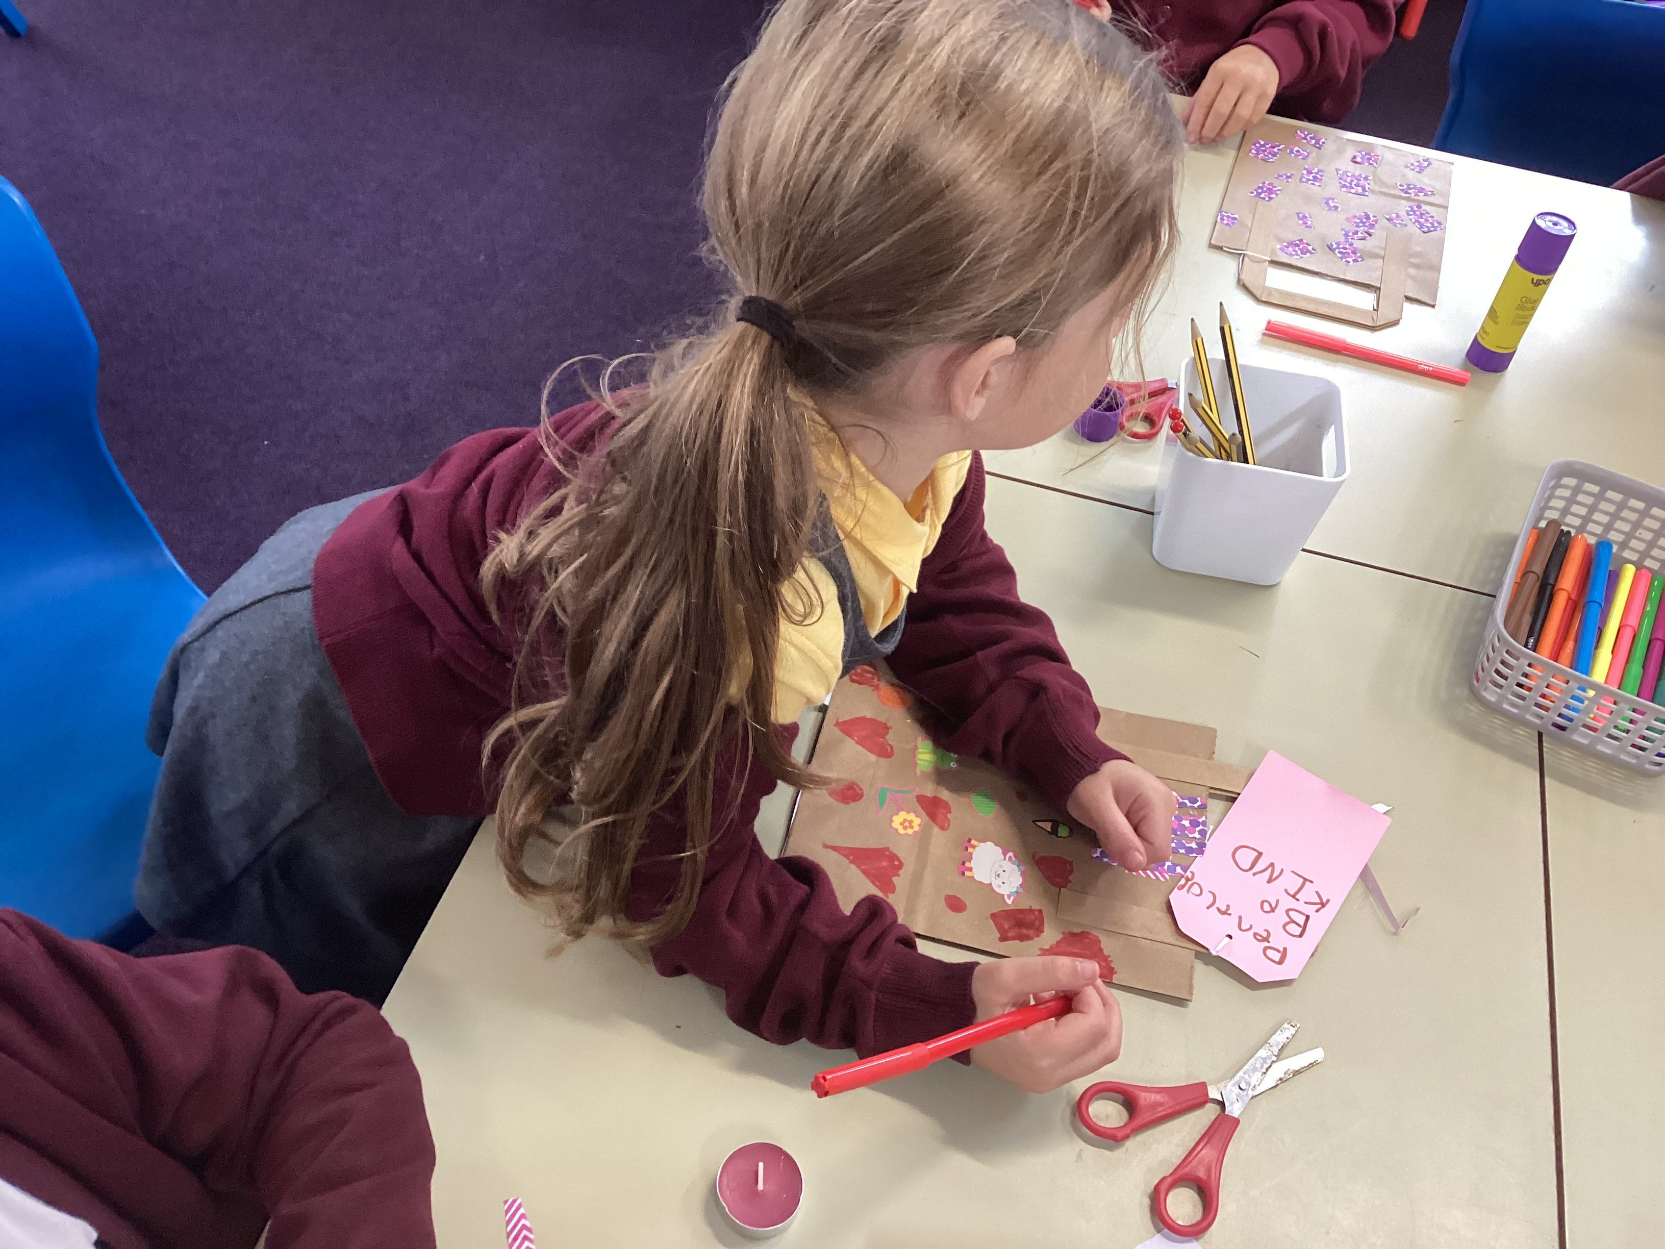
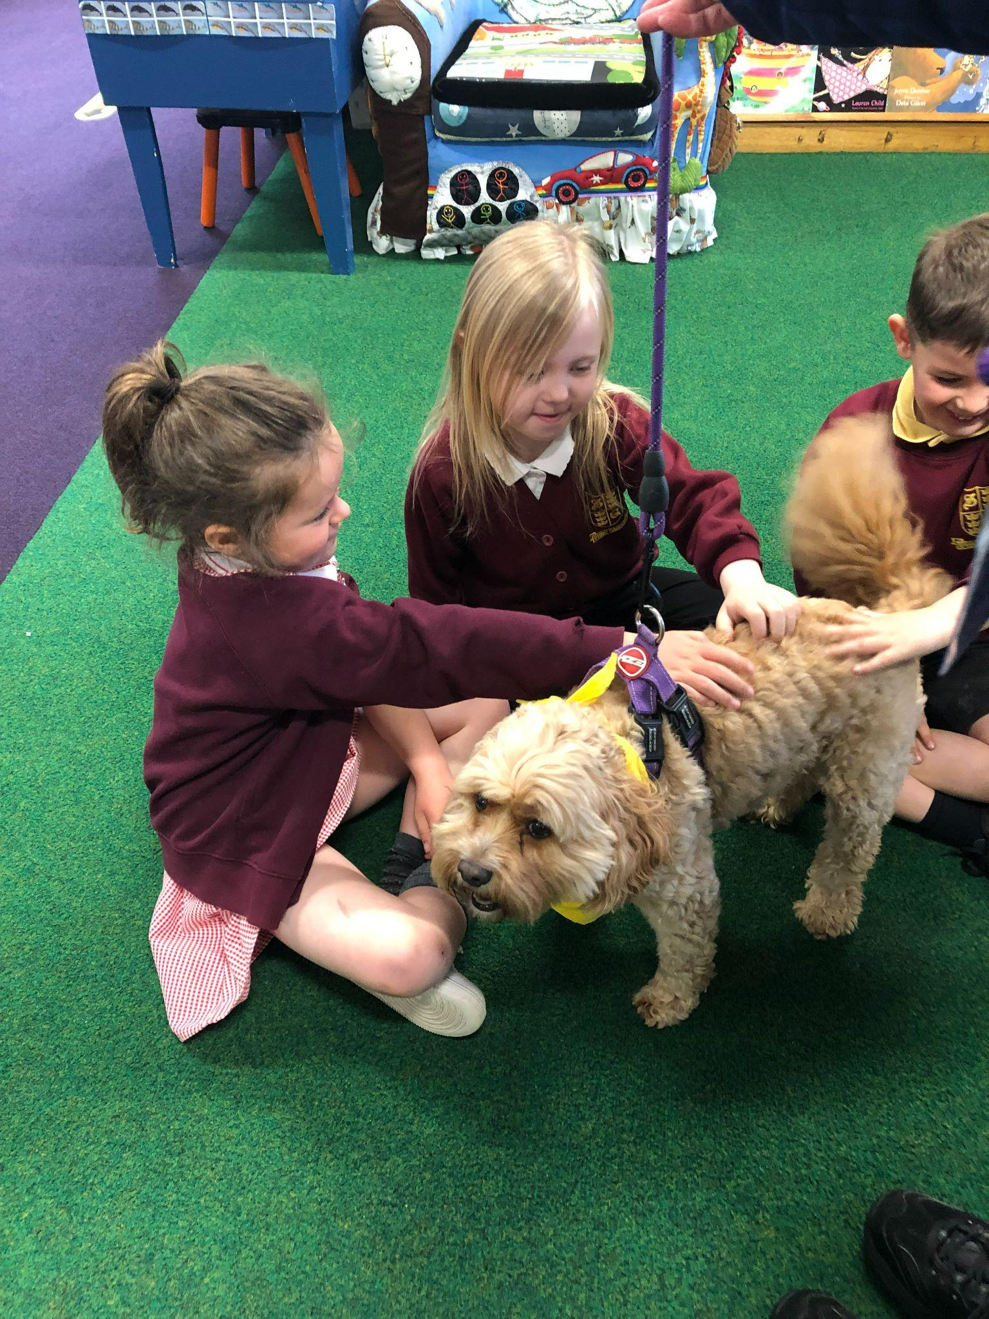
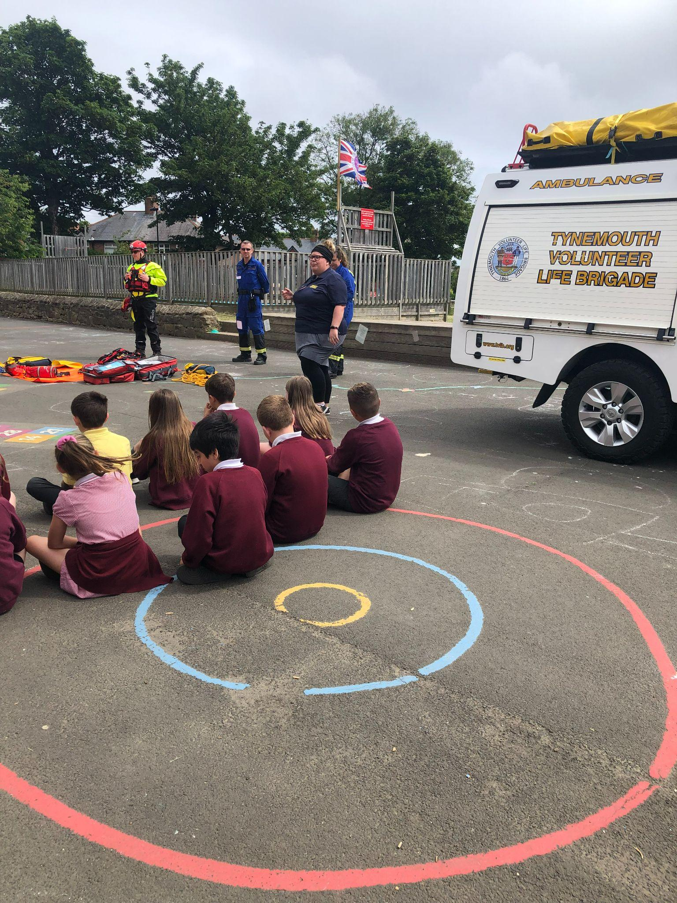

Parent Transition Meetings
2025-26

Slide 2

Transition meetings for parents/carers
Year 4
2025-26

Slide 3
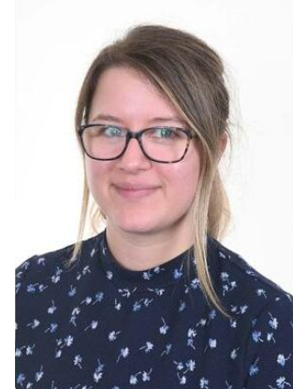
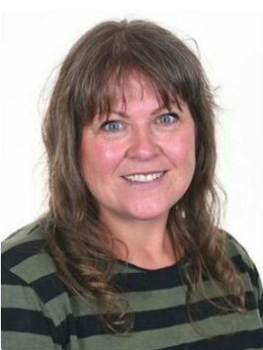
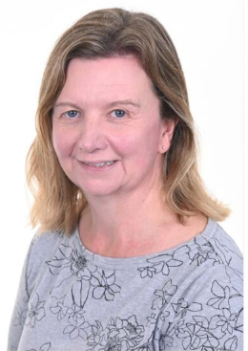
The teachers for Year 4
Class 8 – Mrs Guy Class 9 – Mrs Wilson and Mrs Wankowicz
Notes:
Year 1 / 2 remove this slide

Slide 4


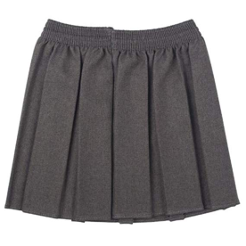
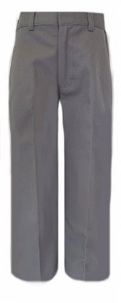
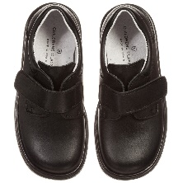
Expectations for next year
Uniform
It is important that your child has the correct uniform to be part of our school community.
Maroon jumper or cardigan (plain maroon sweaters or logo are acceptable)
White or yellow polo shirt or white blouse/shirt (plain or logo)
Trousers - grey (plain) no jeans or denim type. Skirts - grey pinafore or grey skirt
Grey or white socks
Black shoes
Yellow or white polo shirts - do not have to have a logo
Summer Uniform
Pupils can wear a maroon, yellow or pink gingham dress.
Please remember that uniform can be ordered from https://www.michaelsehgal.co.uk/
Notes:
Uniform from Emblematic is still ok - it’s just that we are with a new supplier.
Name all items.
Letter with PE days to be sent out in September - home at end of the week.
Reminder: make-up/nails/nail varnish/jewellery

Slide 5



Please name your child’s belongings!
It’s very hard to reunite lost uniform when they’re all the same size/style!

Slide 6
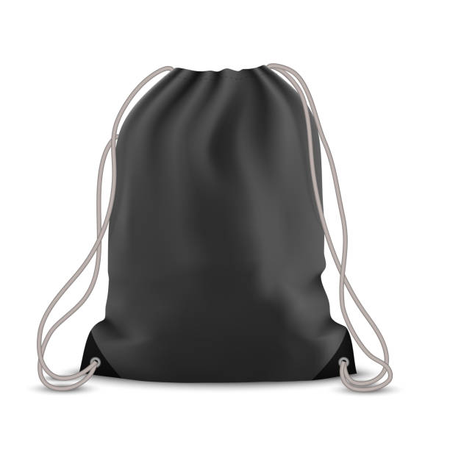
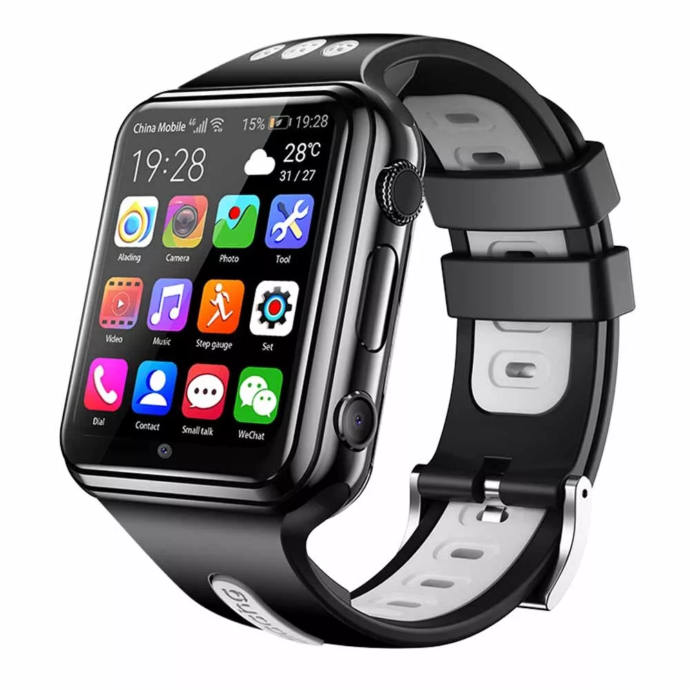

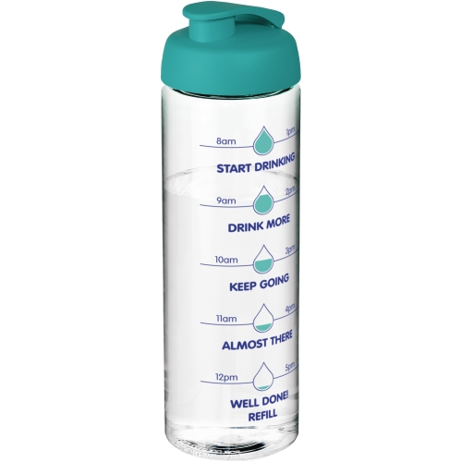
Expectations for next year
Please ensure that your child has a yellow PE top, black shorts and trainers in a named drawstring bag that they can keep on their peg. Swimming lessons will start after the Easter holidays for the summer term.
Smart Watches are not allowed to be worn in school
Earrings – Only ONE STUD earring in each ear. If your child has their ears pierced it is important that they can take them out on their own for PE. If they can’t, it is important that they are removed before school on the days they have PE. Please wait until the summer holidays to get ears pierced.
Water Bottles - Please send your child to school with a clear bottle every day so that they can fill it with water.

Slide 7
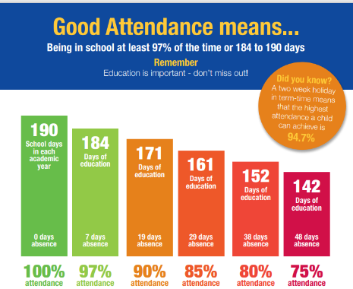
Attendance
As a school, Spring Gardens recognises the importance of high attendance.
Whilst there are many reasons that children may be out of school it is imperative that children attend to ensure they are able to progress and retain the learning.
No holidays in term time will be authorised.
The school MUST be notified for any absence using the leave of absence form.
Notes:
Dates for SATs week (08.05.23-11.05.23) and lead up.
Breakfast club
Anxiety - strategies
Self-care: importance of sleep/managing/limiting devices

Slide 8
School Lunches
Your child may choose to have a school dinner or bring their own packed lunch
All children eat in the dinner hall except during the summer term and the weather permits packed lunches to be eaten outside if they choose
As we have children with allergies in school, NO NUT BASED PRODUCTS should be included in packed lunches. If a child is known to have a nut based product this will be removed from their packed lunch and given to the adult collecting at the end of the day
School lunches are provided by Hutchison Catering and must be ordered in advance
https://appetite.hutchisoncatering.co.uk/
Payment for lunches needs to be done through their system
Please note, the cost of a school dinner will be increasing to £2.55 from September
Menus can be found on our school website - https://www.springgardensprimary.org.uk/lunch-menus/
PLEASE NOTE - IN YEAR 3 THERE IS NO UNIVERSAL FREE SCHOOL MEALS SO IF YOU HAVEN’T APPLIED FOR OR DON’T QUALIFY FOR FREE SCHOOL MEALS YOU WILL HAVE TO PAY FOR THEM
For more information - https://my.northtyneside.gov.uk/category/238/free-school-meals

Slide 9
The School Day
The start to the school day;
Breakfast club starts at 8:00am. No child should be onsite unaccompanied before this time – The school gates will only be open just before 8:00am
Parents/carers must pre-book children onto breakfast club - information can be found on the school website - Wrap Around Care - Spring Gardens Primary School - North Shields
  Staff on yard - 8:45am
  Children enter the building - 8:50am
  Gates locked - 8:55am
Please make sure your child is in the line to come in with their class at 8:50am so they have a calm and controlled start to their day
End of day - 3:20pm (Year 1 - 6)
Notes:
We are very lucky to still be able to provide a breakfast club for children. They enjoy time with their friends and get breakfast so they are fuelled for the day.
We are always here to support your child’s learning: staff are on the yard if you need to mention/ask anything before the start of the school day or you can ring/email the school office if you require to speak to us at greater length.
Children need to be prepared for the school day: school bags need to be brought to school every day with their reading books within.

Slide 10
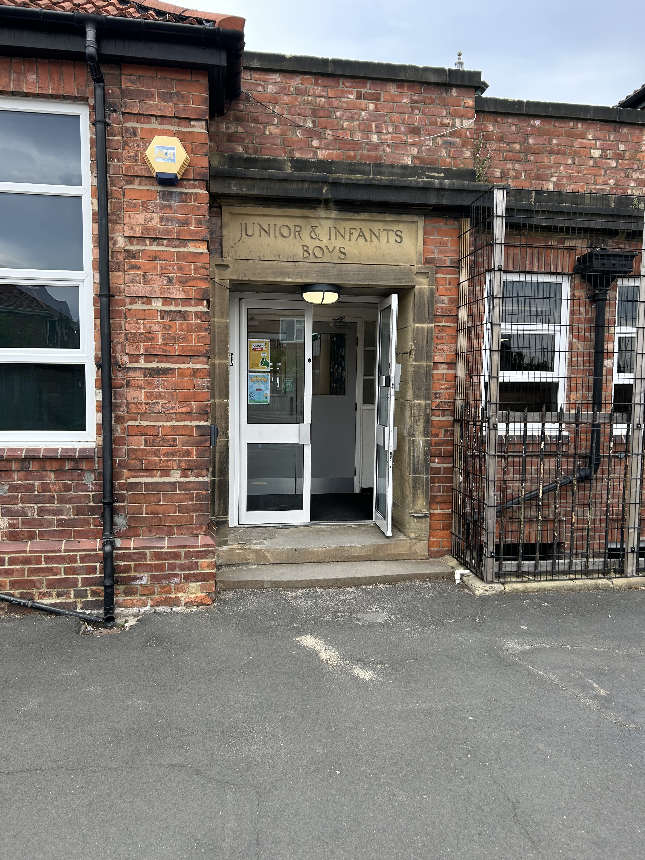
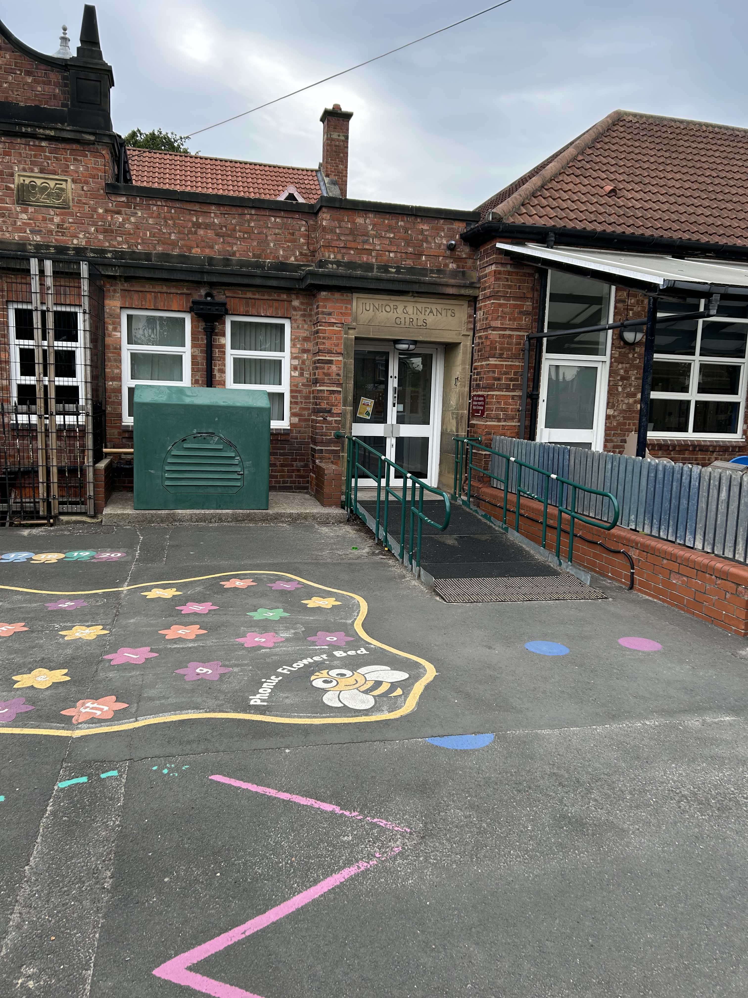
The School Day
Year 3 and 4 children will enter and exit through this door
We are making some changes to the way the older children come into and leave the building at the start and end of the day.
From September;
Year 5 and 6 will line up on the KS 1 yard next to year 3/4
Year 5 and 6 will come into the building through the door with the ramp, once all Reception children have entered. The children will also leave through these doors.
This has all been explained to the children during their move up morning.
Year 5 and 6 children will enter and exit through this door

Slide 11
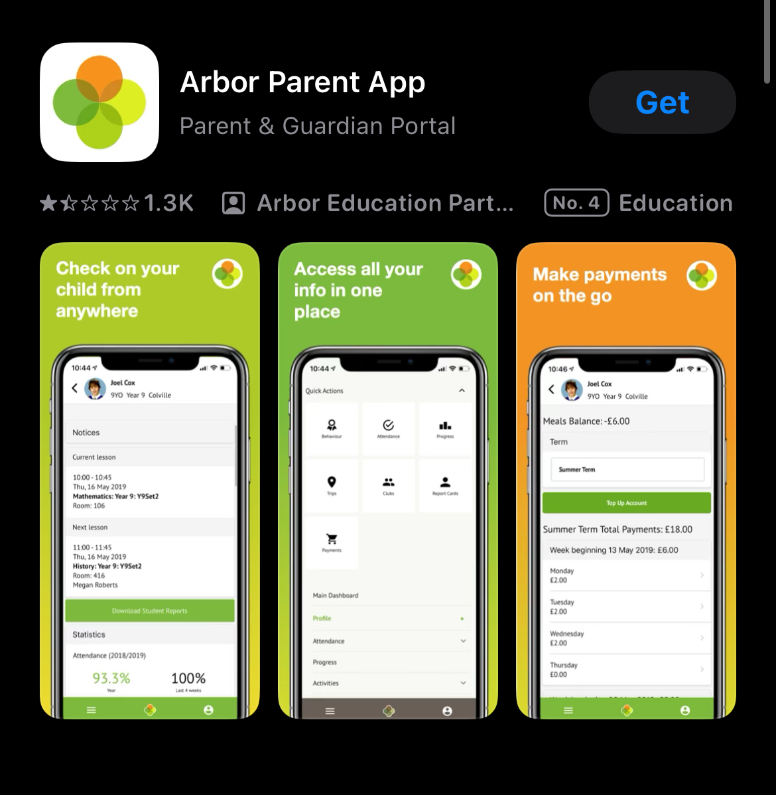
Communication, payments, booking and permissions
We ask that parents/carers download the Arbor Parent App as this will be used for communication, payments, bookings and permission requests
This will take away the need for multiple systems of communication
Parents will also be able to use this to change their contact details and view their child’s up to date attendance

Slide 12
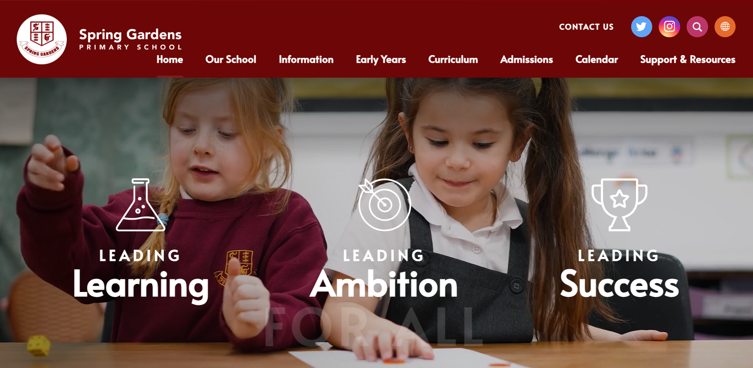
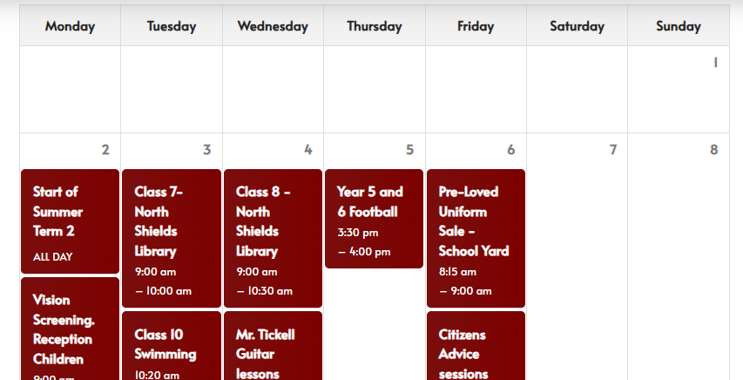

Communication, payments, booking and permissions
The school website is a great resource from the calendar for keeping on top of school events to links for supporting your child online
Keep up to date with what’s happening in school on social media through Instagram and Facebook

Slide 13
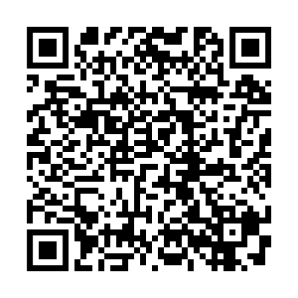
Collection Policy
Our school collection policy can be viewed here
Parents/carers must note that up to year 5, all children must be collected by a trusted adult or sibling who is in Secondary school.
Siblings in year 5 or 6 are not able to collect and be responsible for younger siblings. Parents/carers must inform school if someone other than the normal adult is collecting by either telling the class teacher, emailing or phoning the school office.
If there is any doubt, school staff will not let the child leave our care until contact has been made with the child’s parent/carer to confirm the arrangement.

Slide 14
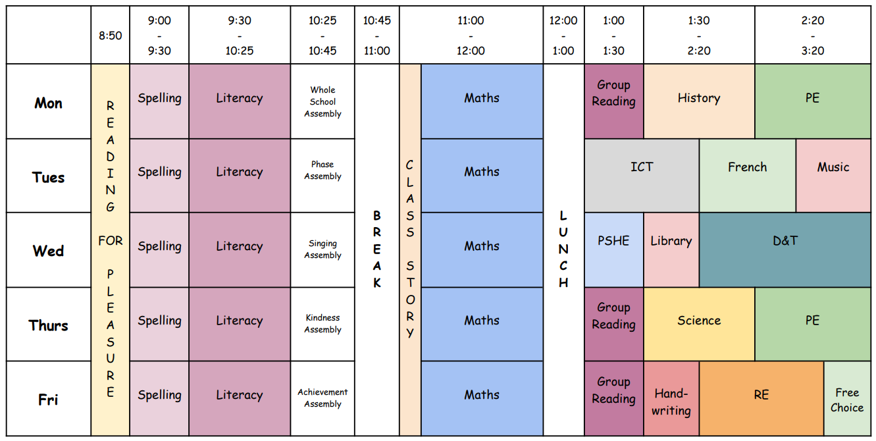
Curriculum - Example of a Weekly Timetable

Slide 15
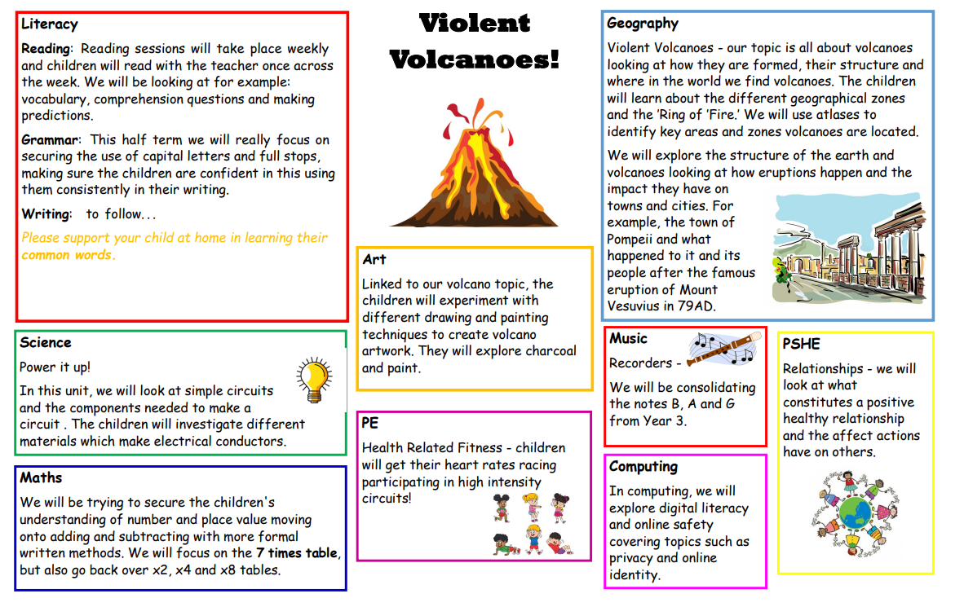
Curriculum - Example of a Curriculum Overview

Slide 16

Curriculum - Phonics & Spelling Sessions
Our new Phonics scheme has been such a success since it was introduced in September 2022.
In Year 3 and 4, the Sounds-Write approach informs our teaching of spelling. The main strategy we use is to break words down into their syllables to help with spelling.

Slide 17
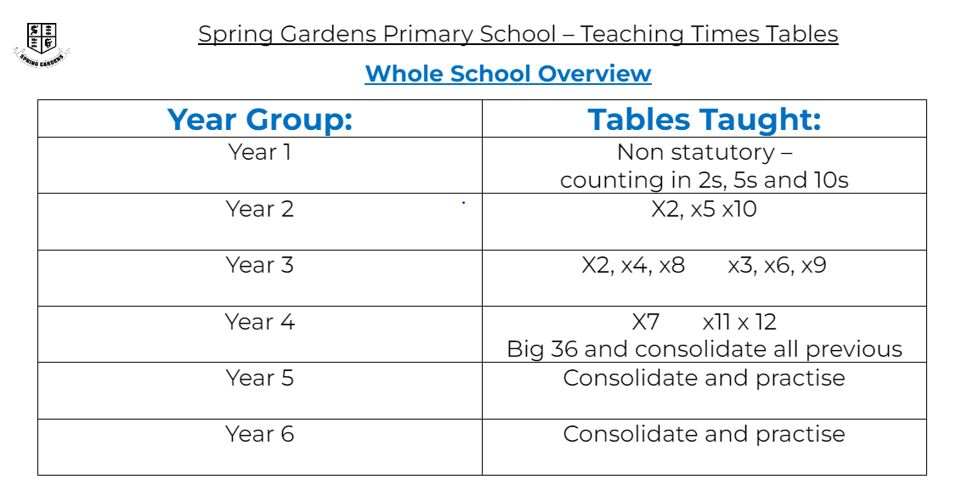
Curriculum - Maths
For Y4: Times Tables Rock Stars
Hit the Button
Multiplication Tables Check - 2024 - Timestables.co.uk

Slide 18
Curriculum - Homework
Thank you for your support!
Literacy Homework
School Reading Book - regular reading aloud please.
Please look after our school reading books. There will be a £5 replacement charge for missing books.
Reading Homework - each week - linked to the book your child is reading. Every time the children do their homework, they will gain a mark on their ‘Reading Bookmark’. The children will earn a special treat at the end of the half-term for completing their bookmark.
Spellings - Statutory Words and Commonly Misspelt Words
At the beginning of the year, spellings will be stuck in the back of your child’s Literacy Homework book, along with fun ideas for how to practise them at home. The children can practise their spellings in the back of their homework book.
Maths Homework
Times Tables – Times Tables Rock Stars, Hit the Button, Multiplication Tables Check - 2024 - Timestables.co.uk
Please support your child with practising their tables at home too.
Additional maths homework will be online using Mathletics.

Slide 19

Home-School Agreement
We recently sent home with your child a copy of our Home – School Agreement. If you haven’t done so already, please read through with your child and sign and return to school.
We believe this to be an important agreement as it not only sets out what school requests from parents/carers but also what you can expect from school.

Slide 20

Any questions?

