Slide 1
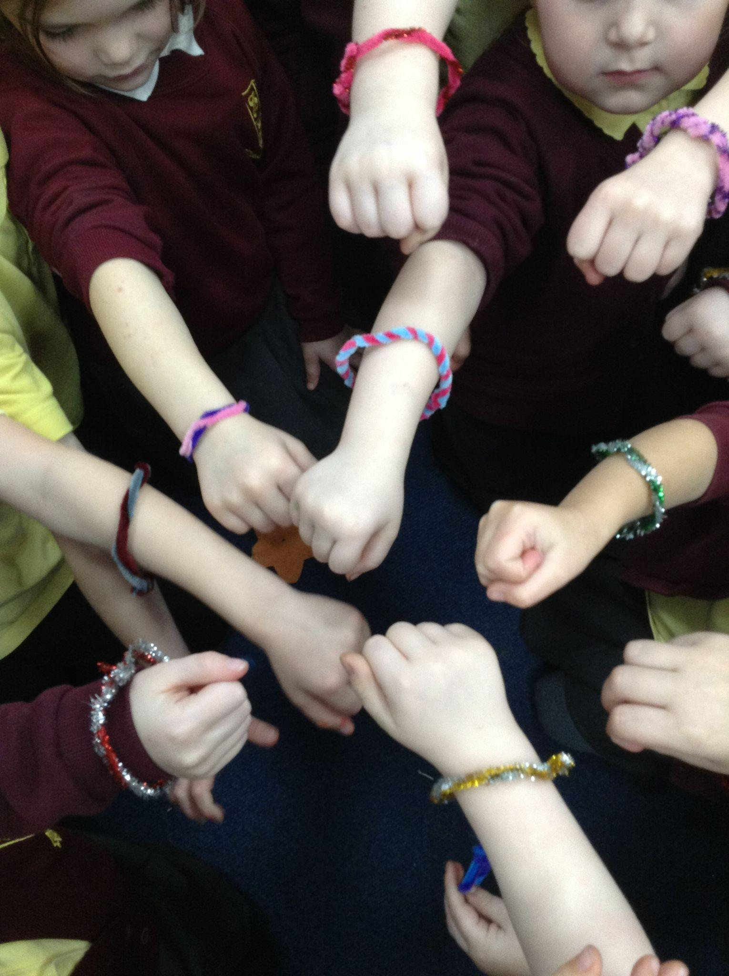
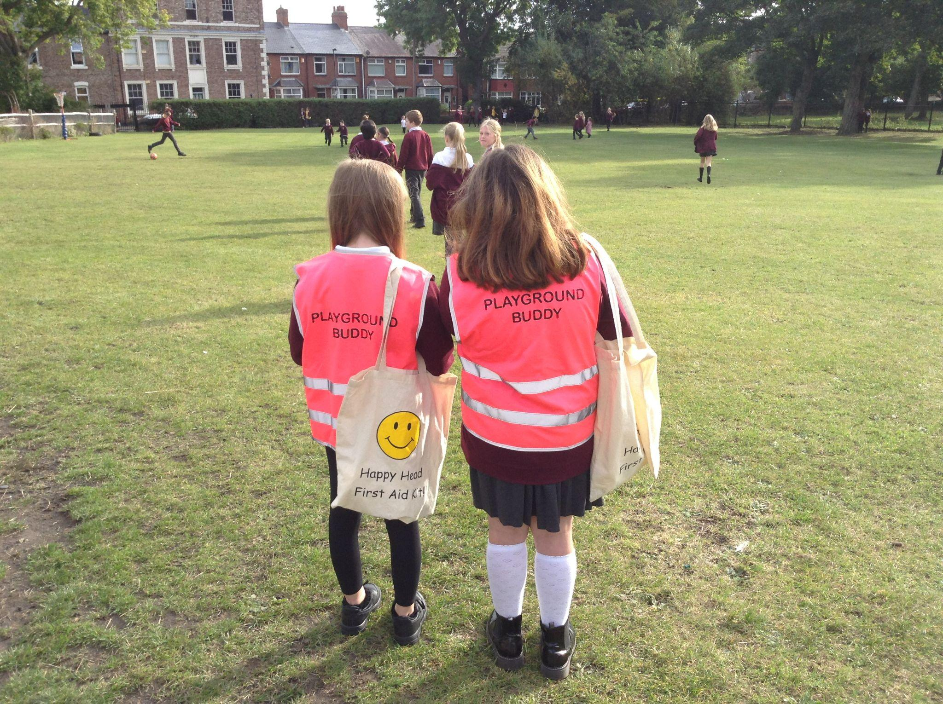
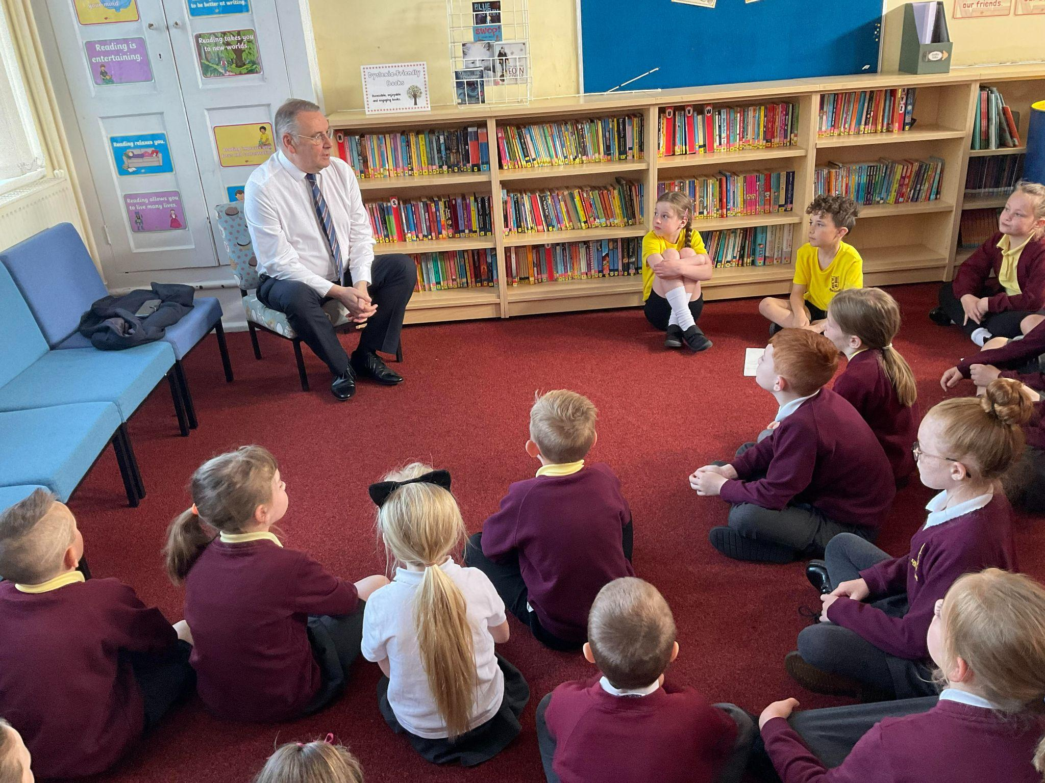
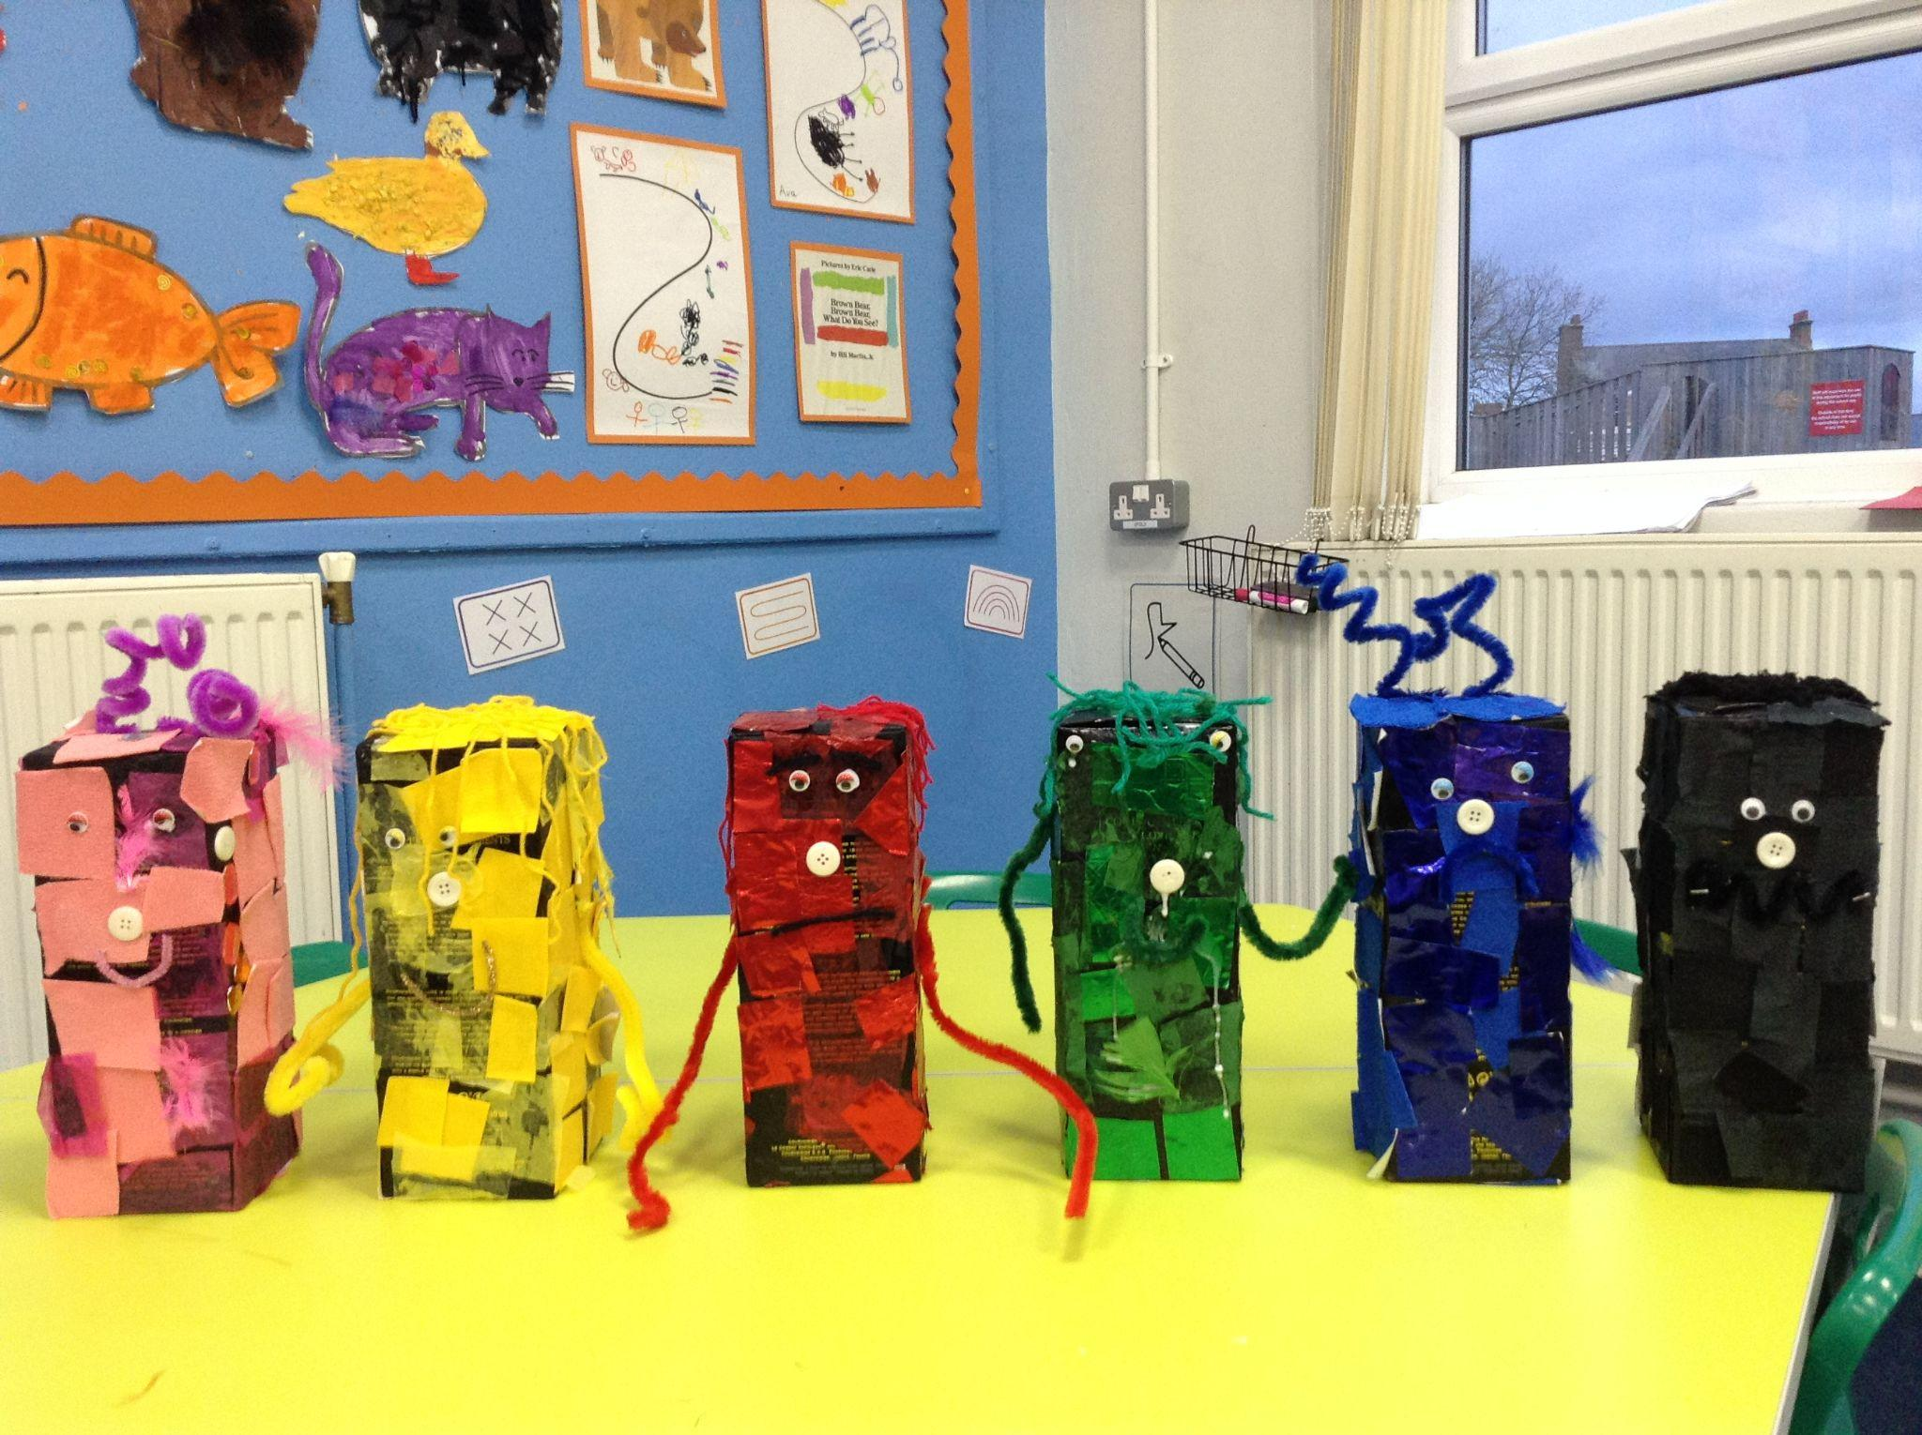
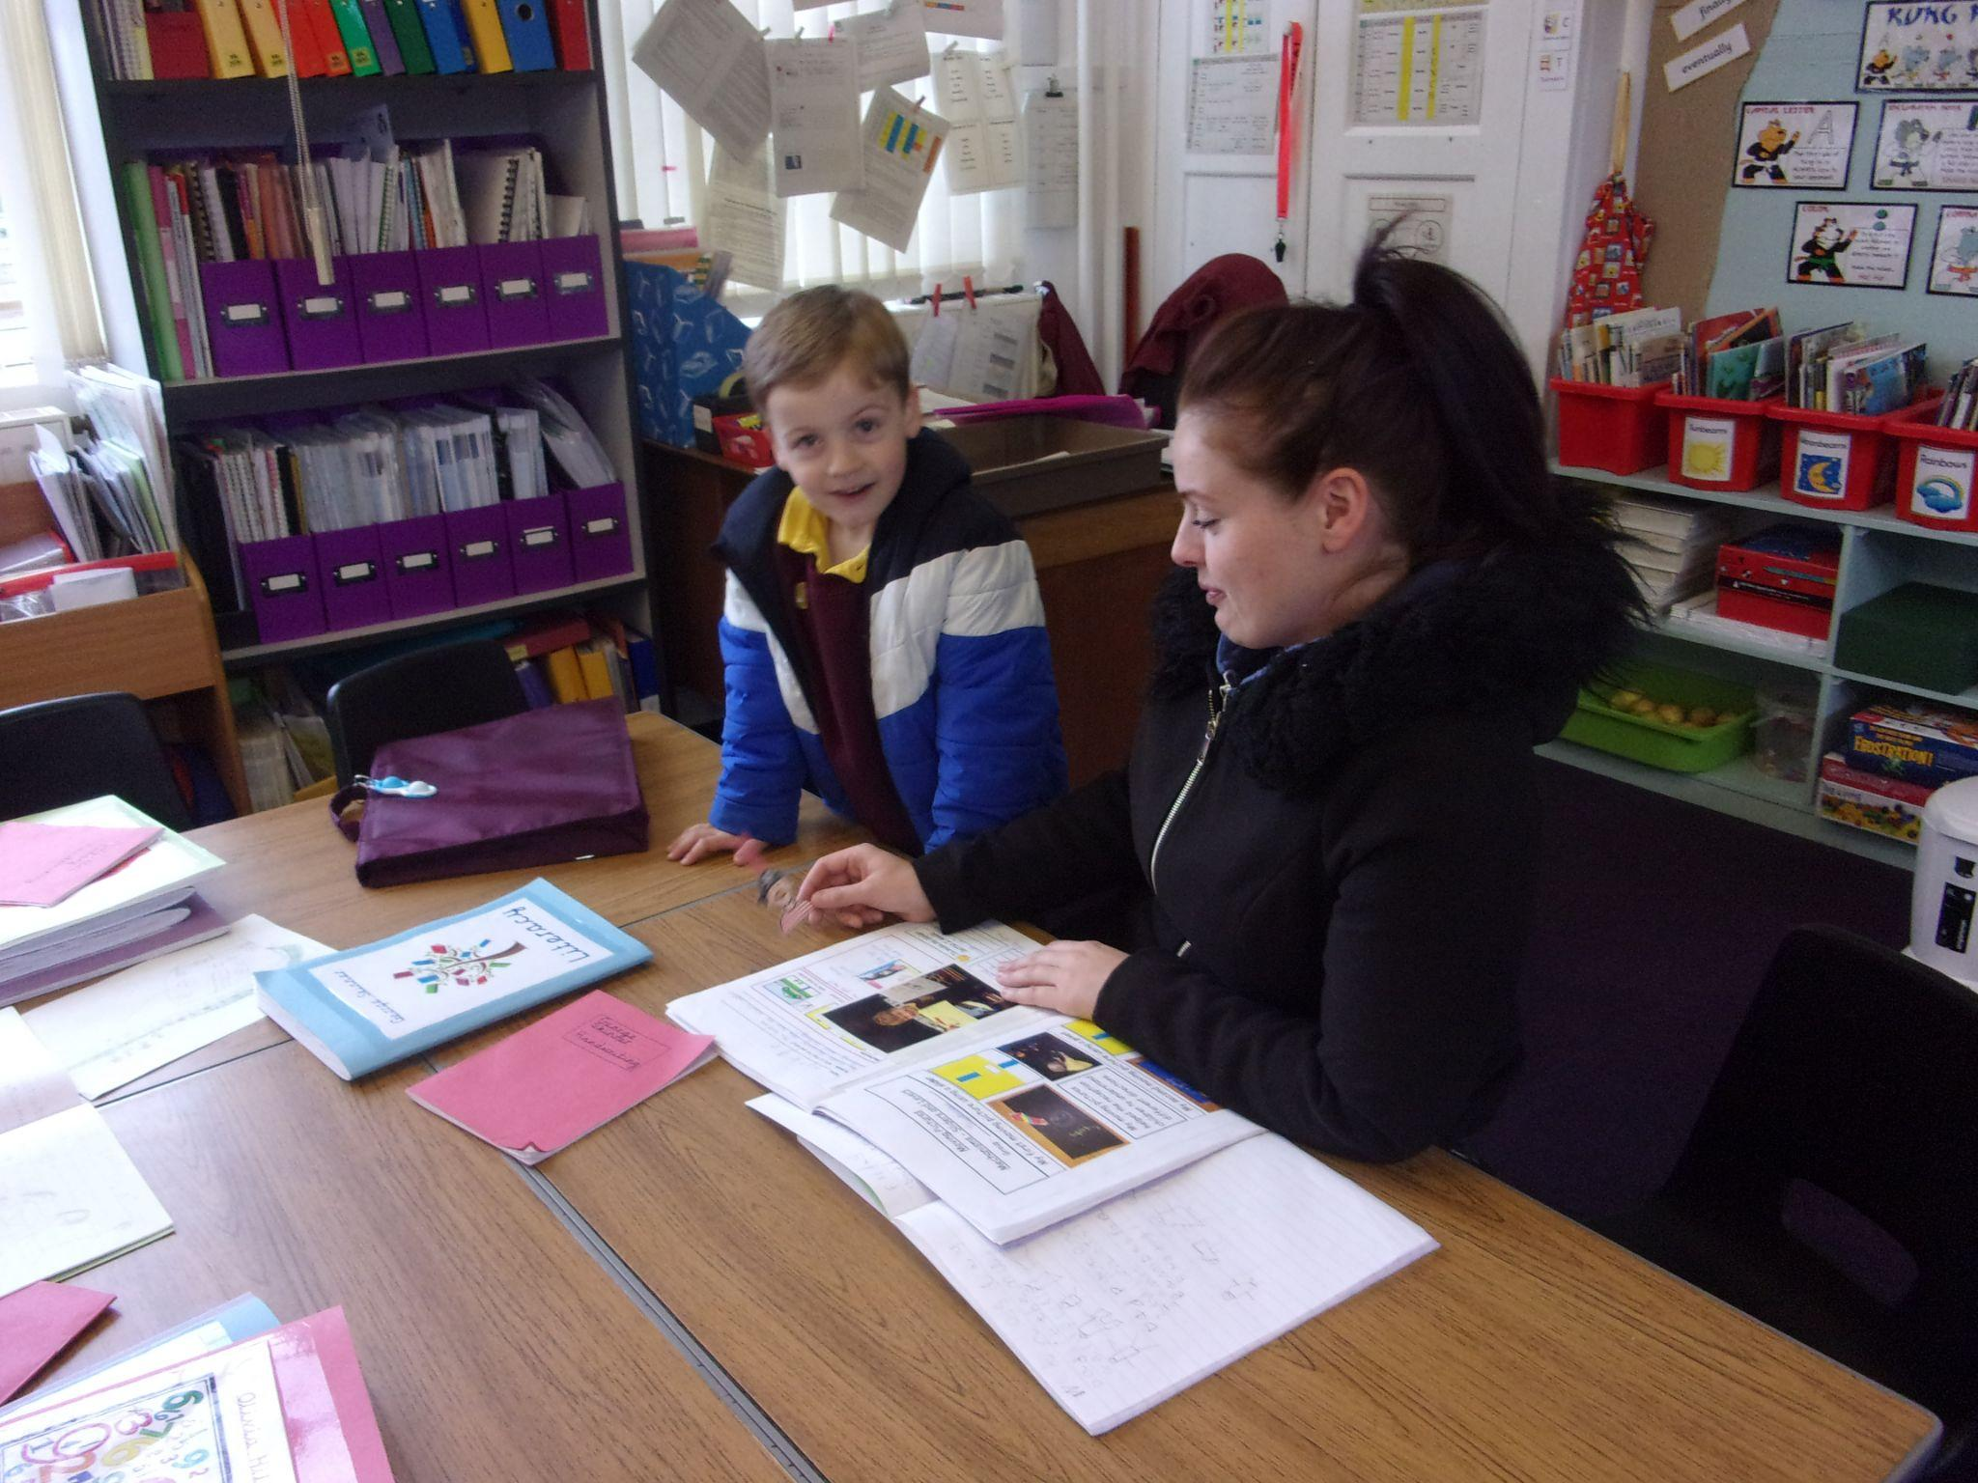
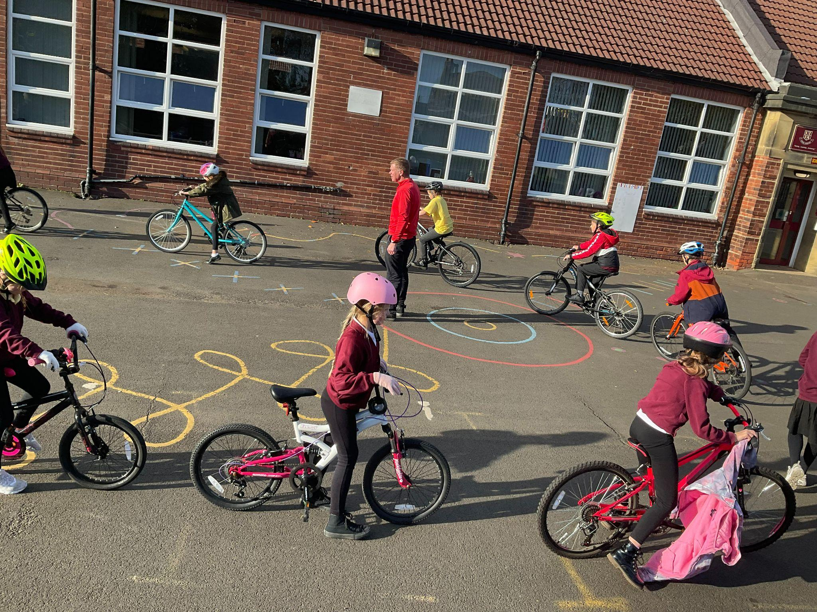
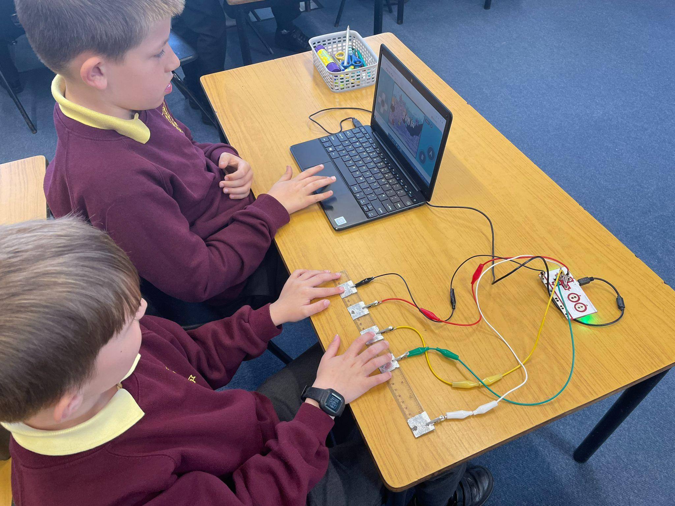
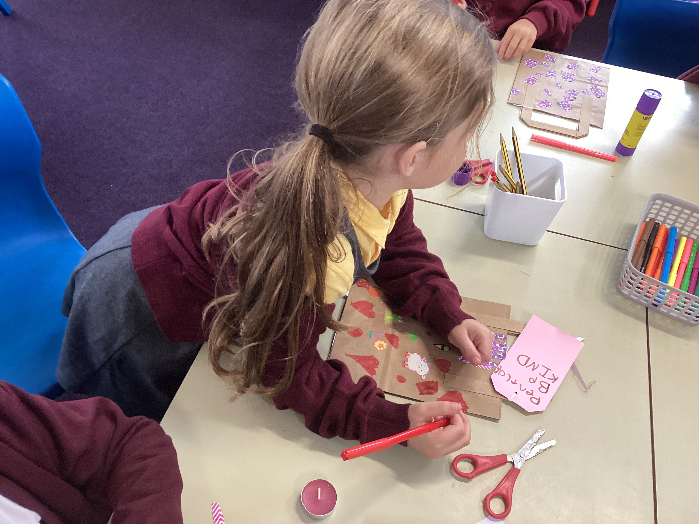
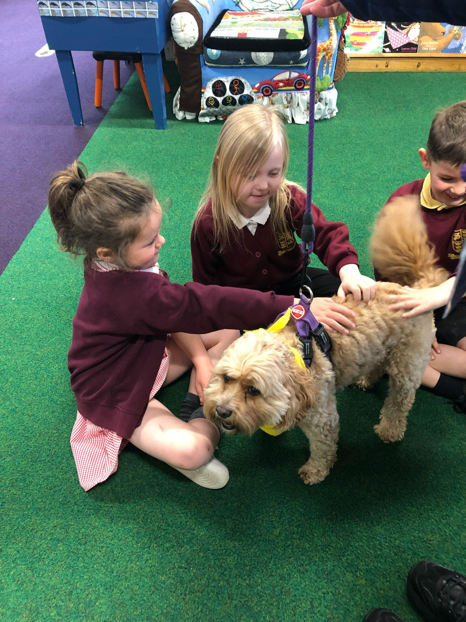
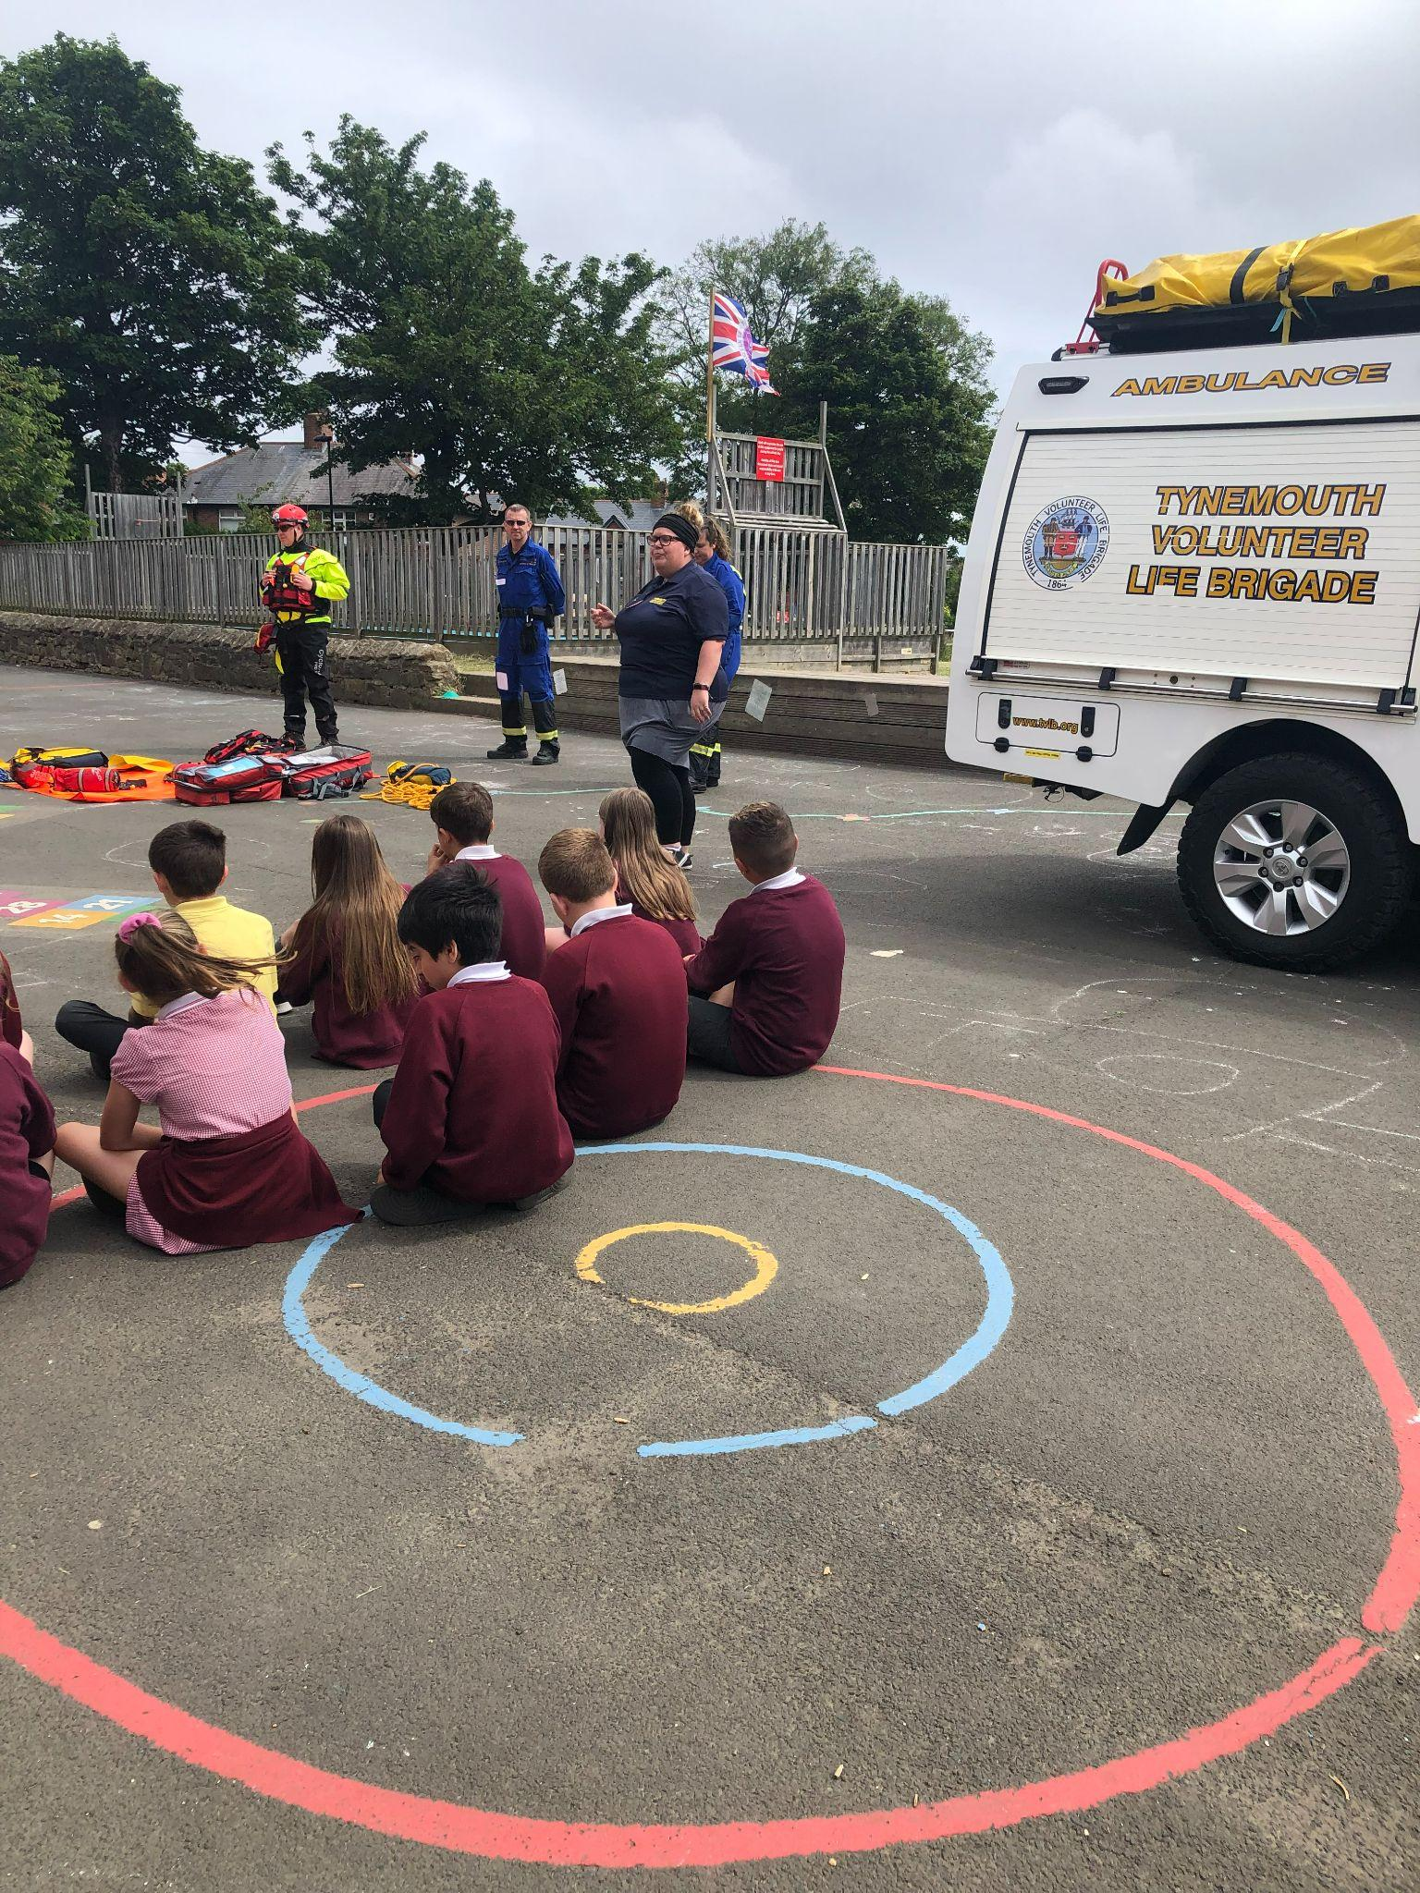
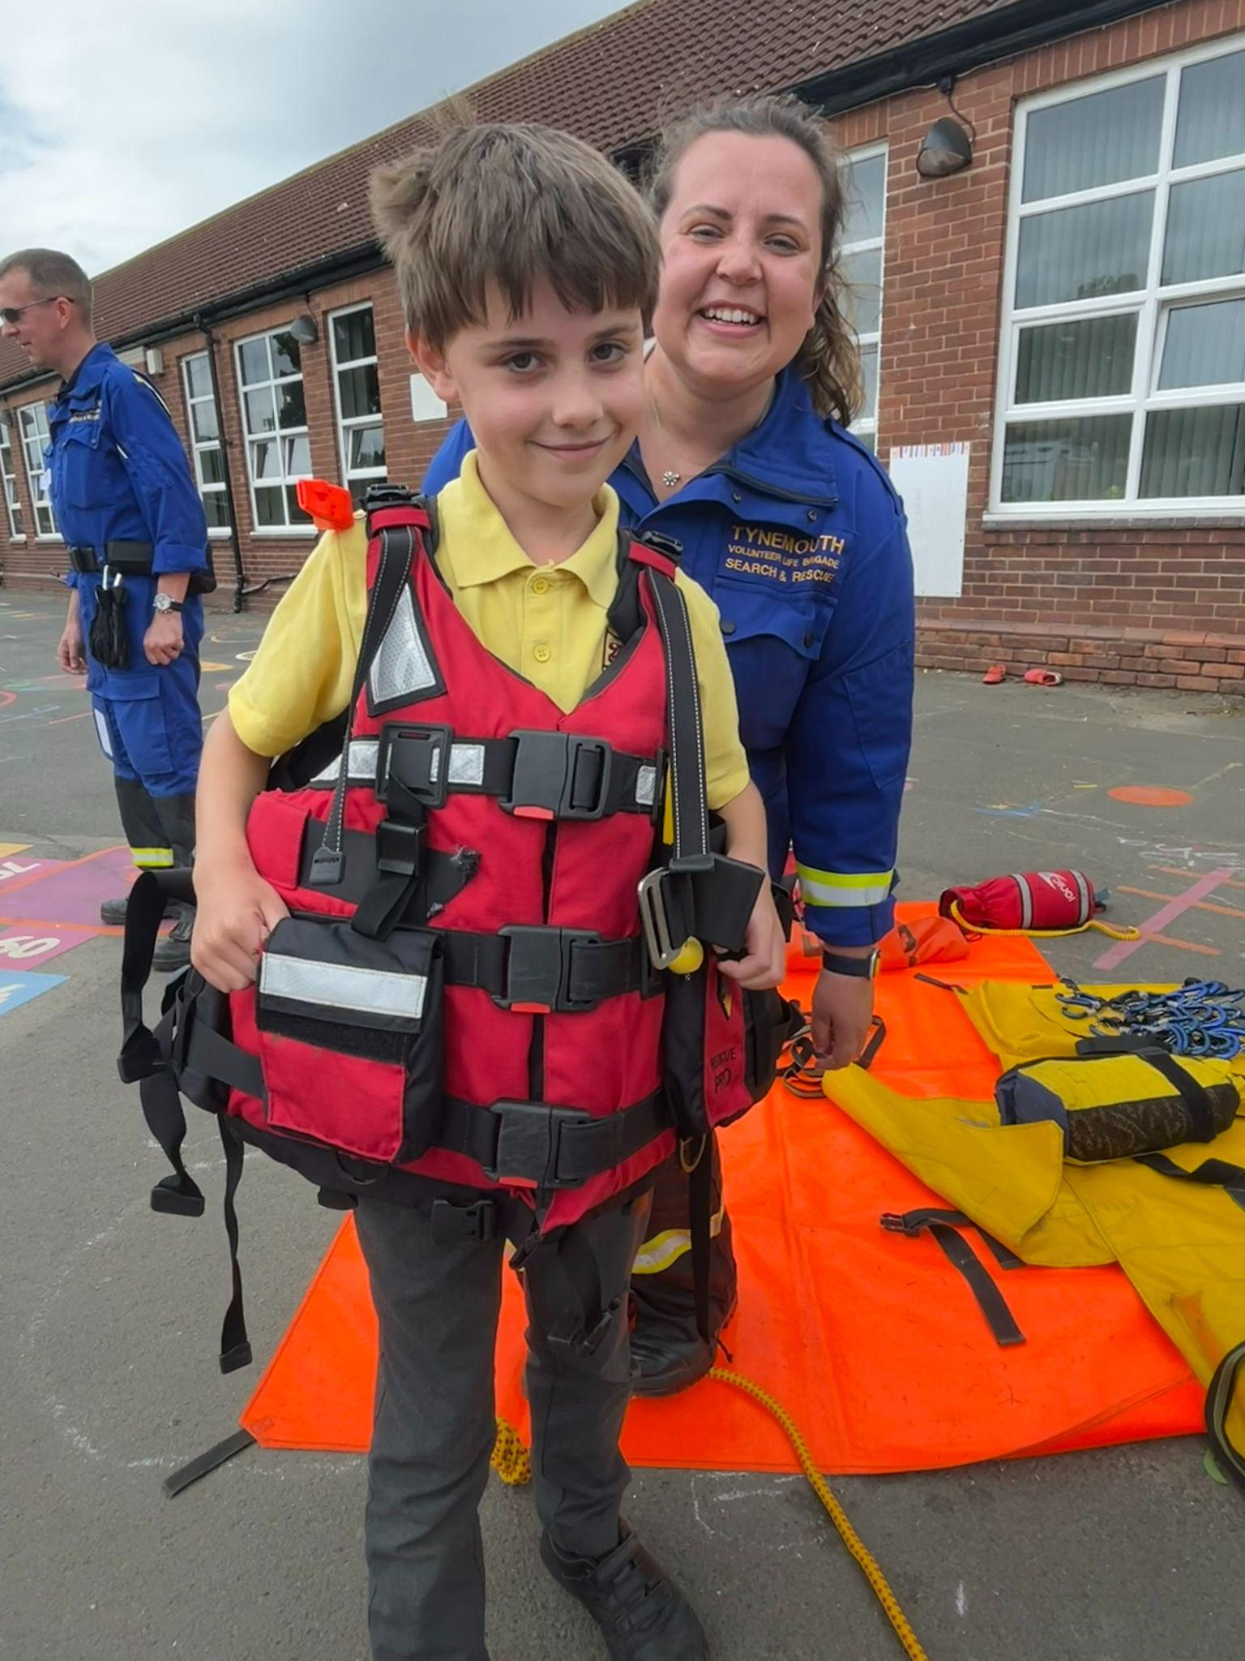
Parent Transition Meetings
2025-26

Slide 2

Transition meetings for parents/carers
Year 5
2025-26

Slide 3
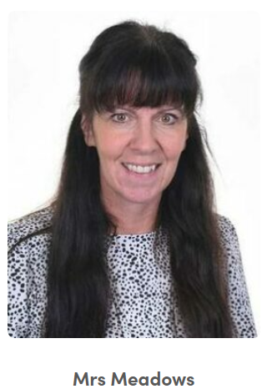
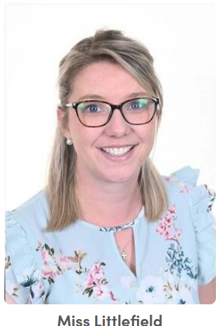
The teachers for Year 5
Class 12 Class 11
Notes:
Year 1 / 2 remove this slide

Slide 4


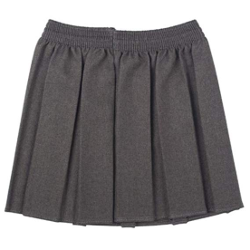
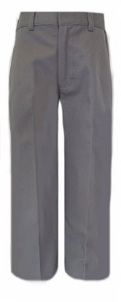
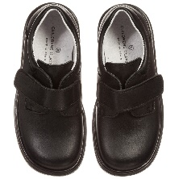
Expectations for next year
Uniform
It is important that your child has the correct uniform to be part of our school community.
Maroon jumper or cardigan (plain maroon sweaters or logo are acceptable)
White or yellow polo shirt or white blouse/shirt (plain or logo)
Trousers - grey (plain) no jeans or denim type. Skirts - grey pinafore or grey skirt
Grey or white socks
Black shoes
Yellow or white polo shirts - do not have to have a logo
Summer Uniform
Pupils can wear a maroon, yellow or pink gingham dress.
Please remember that uniform can be ordered from https://www.michaelsehgal.co.uk/
Notes:
Uniform from Emblematic is still ok - it’s just that we are with a new supplier.
Name all items.
Letter with PE days to be sent out in September - home at end of the week.
Reminder: make-up/nails/nail varnish/jewellery

Slide 5



Please name your child’s belongings!
It’s very hard to reunite lost uniform when they’re all the same size/style!

Slide 6
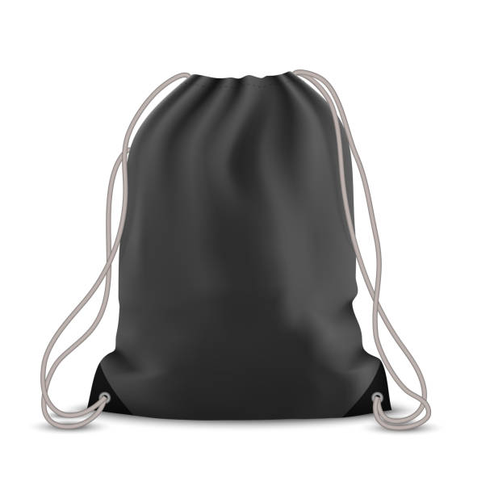
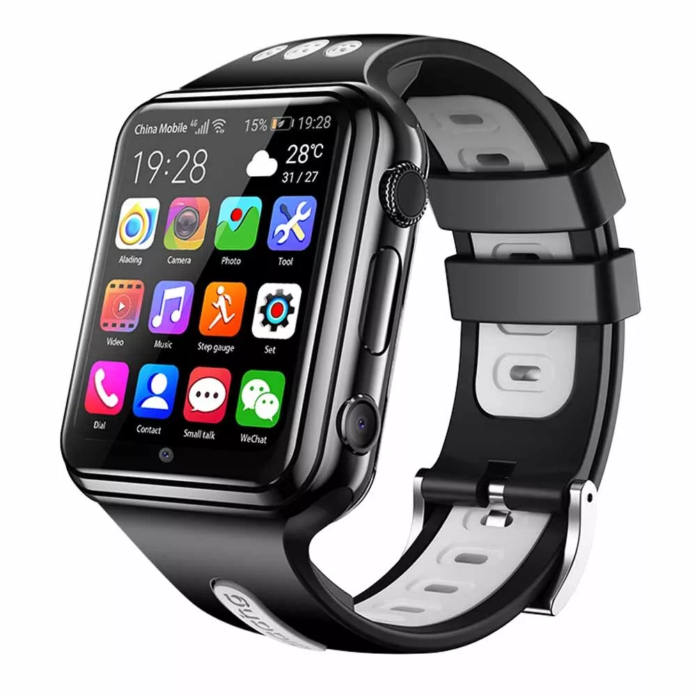



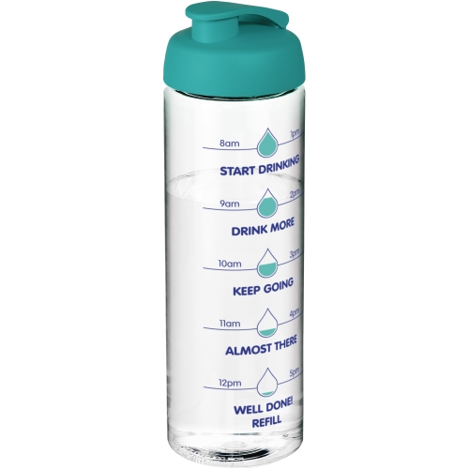
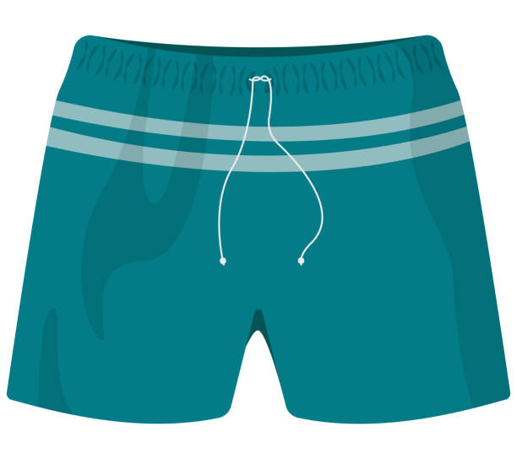
Expectations for next year
Summer Term-Please ensure that your child has a yellow PE top, black shorts and trainers in a named drawstring bag that they can keep on their peg.
Smart Watches are not allowed to be worn in school
Earrings – Only ONE STUD earring in each ear. If your child has their ears pierced it is important that they can take them out on their own for swimming/PE. If they can’t, it is important that they are removed before school on the days they have PE. Please wait until the summer holidays to get ears pierced.
Water Bottles - Please send your child to school with a clear bottle every day so that they can fill it with water.
Notes:
NO PE KIT in AUTUMN/SPRING unless specified for events or clubs.
Peg space is limited so having PE kit in a smaller bag and separate bag for school books will help.
Water bottles will go home each night to be appropriately cleaned.
We go swimming in Autumn and Spring. Children will need a full swimming costume/shorts that are above their knee. Swim caps will help keep their hair dry. Needs to be tied up. Can bring goggles. Earrings must be removed by the child.
We have made a decision to move away from plimsoles to trainers due to a number of reasons: limited ankle support, not ideal in the rain and no grip.

Slide 7
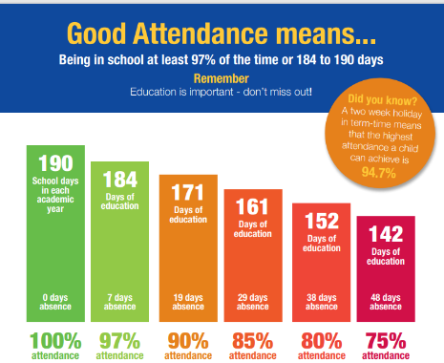
Attendance
As a school, Spring Gardens recognises the importance of high attendance.
Whilst there are many reasons that children may be out of school it is imperative that children attend to ensure they are able to progress and retain the learning.
No holidays in term time will be authorised.
The school MUST be notified for any absence using the leave of absence form.
Notes:
Dates for SATs week (08.05.23-11.05.23) and lead up.
Breakfast club
Anxiety - strategies
Self-care: importance of sleep/managing/limiting devices

Slide 8

School Lunches
Your child may choose to have a school dinner or bring their own packed lunch
All children eat in the dinner hall except during the summer term and the weather permits packed lunches to be eaten outside if they choose
As we have children with allergies in school, NO NUT BASED PRODUCTS should be included in packed lunches. If a child is known to have a nut based product this will be removed from their packed lunch and given to the adult collecting at the end of the day
School lunches are provided by Hutchison Catering and must be ordered in advance
https://appetite.hutchisoncatering.co.uk/
Payment for lunches needs to be done through their system
Please note, the cost of a school dinner will be increasing to £2.55 from September
Menus can be found on our school website - https://www.springgardensprimary.org.uk/lunch-menus/
PLEASE NOTE - FROM YEAR 3 THERE IS NO UNIVERSAL FREE SCHOOL MEALS SO IF YOU HAVEN’T APPLIED FOR OR DON’T QUALIFY FOR FREE SCHOOL MEALS YOU WILL HAVE TO PAY FOR THEM
For more information - https://my.northtyneside.gov.uk/category/238/free-school-meals

Slide 9
The School Day
The start to the school day;
Breakfast club starts at 8:00am. No child should be onsite unaccompanied before this time – The school gates will only be open just before 8:00am
Parents/carers must pre-book children onto breakfast club - information can be found on the school website - Wrap Around Care - Spring Gardens Primary School - North Shields
  Staff on yard - 8:45am
  Children enter the building - 8:50am
  Gates locked - 8:55am
Please make sure your child is in the line to come in with their class at 8:50am so they have a calm and controlled start to their day
End of day - 3:20pm (Year 1 - 6)
Notes:
We are very lucky to still be able to provide a breakfast club for children. They enjoy time with their friends and get breakfast so they are fuelled for the day.
We are always here to support your child’s learning: staff are on the yard if you need to mention/ask anything before the start of the school day or you can ring/email the school office if you require to speak to us at greater length.
Children need to be prepared for the school day: school bags need to be brought to school every day with their reading books within.

Slide 10
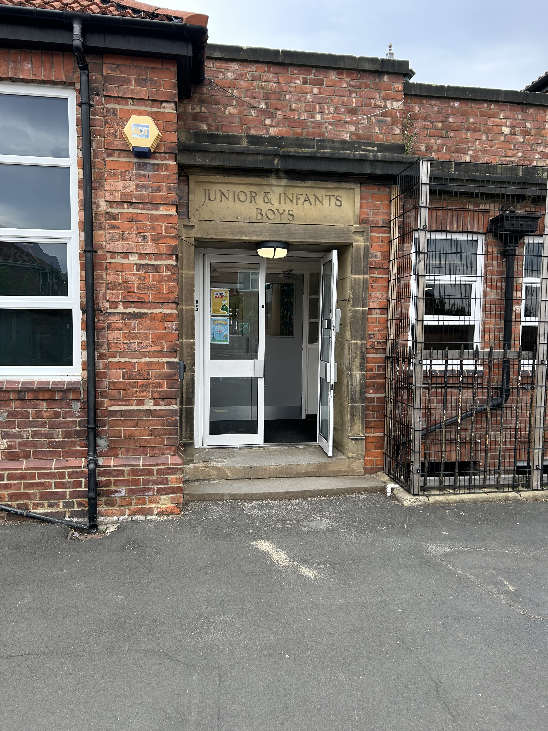
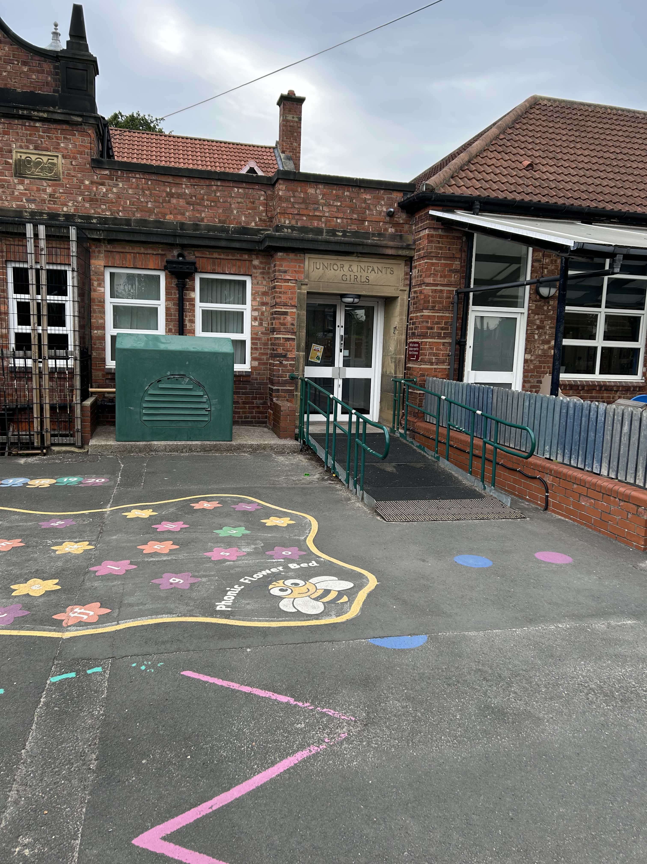
The School Day
Year 3 and 4 children will enter and exit through this door
We are making some changes to the way the older children come into and leave the building at the start and end of the day.
From September;
Year 5 and 6 will line up on the KS 1 yard next to year 3/4
Year 5 and 6 will come into the building through the door with the ramp, once all Reception children have entered. The children will also leave through these doors.
This has all been explained to the children during their move up morning.
Year 5 and 6 children will enter and exit through this door

Slide 11
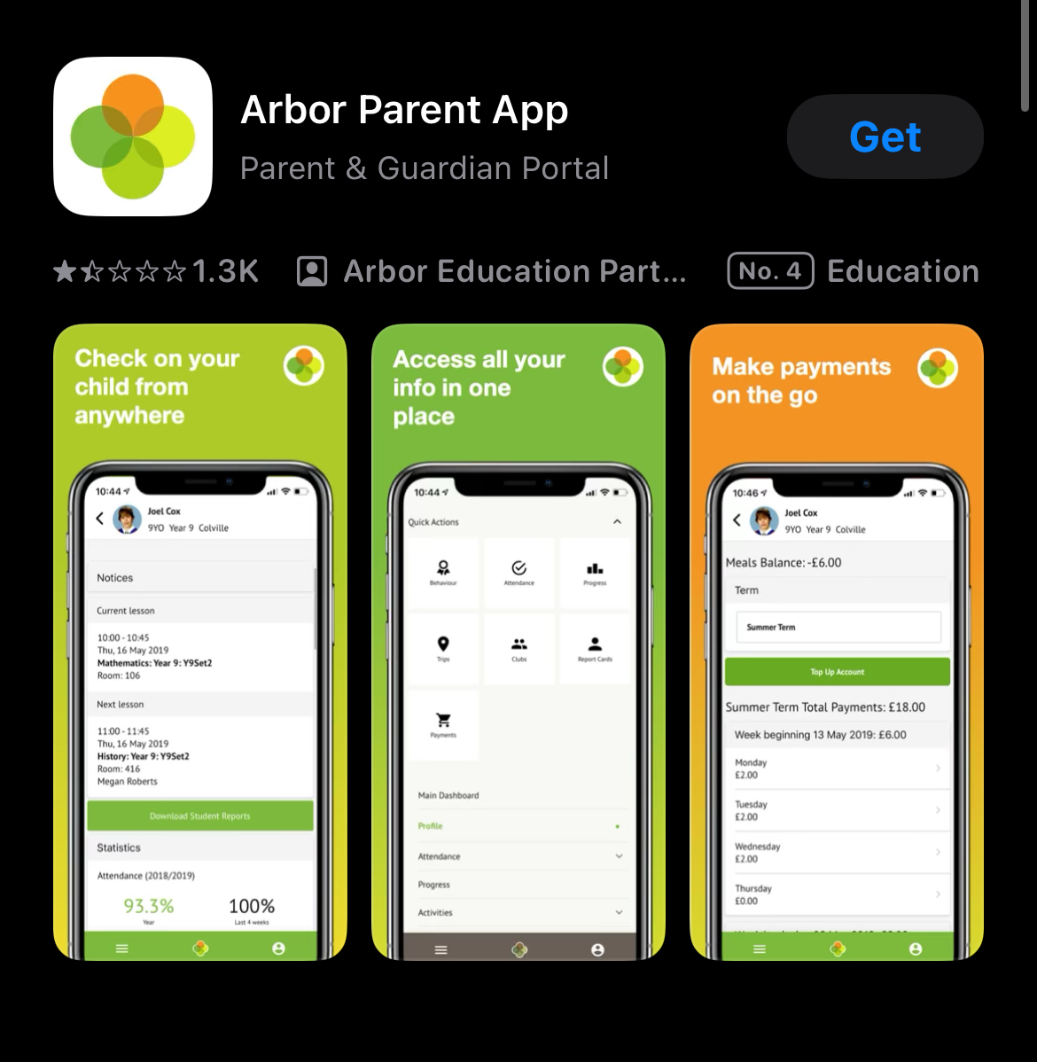
Communication, payments, booking and permissions
We ask that parents/carers download the Arbor Parent App as this will be used for communication, payments, bookings and permission requests
This will take away the need for multiple systems of communication
Parents will also be able to use this to change their contact details and view their child’s up to date attendance

Slide 12
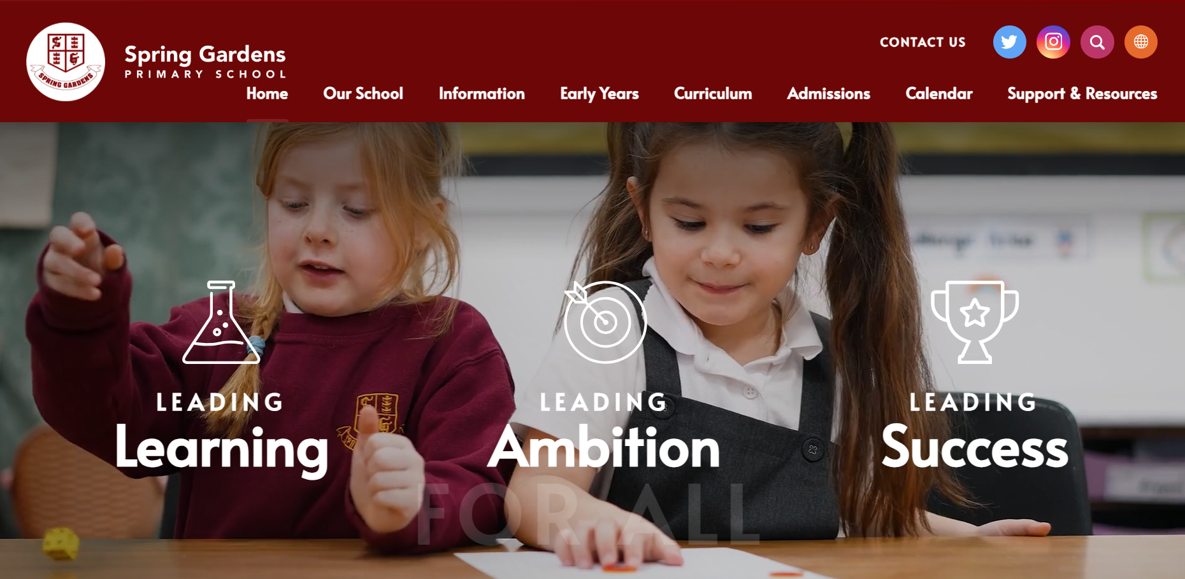
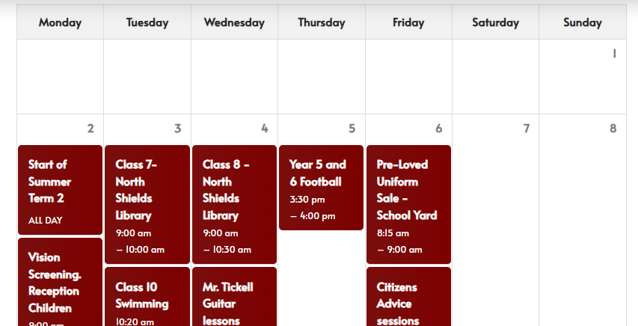

Communication, payments, booking and permissions
The school website is a great resource from the calendar for keeping on top of school events to links for supporting your child online
Keep up to date with what’s happening in school on social media through Instagram and Facebook

Slide 13
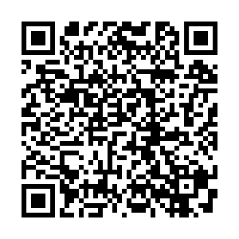
Collection Policy
Our school collection policy can be viewed here
Parents/carers must note that up to year 5, all children must be collected by a trusted adult or sibling who is in Secondary school.
Siblings in year 5 or 6 are not able to collect and be responsible for younger siblings. Parents/carers must inform school if someone other than the normal adult is collecting by either telling the class teacher, emailing or phoning the school office.
If there is any doubt, school staff will not let the child leave our care until contact has been made with the child’s parent/carer to confirm the arrangement.

Slide 14
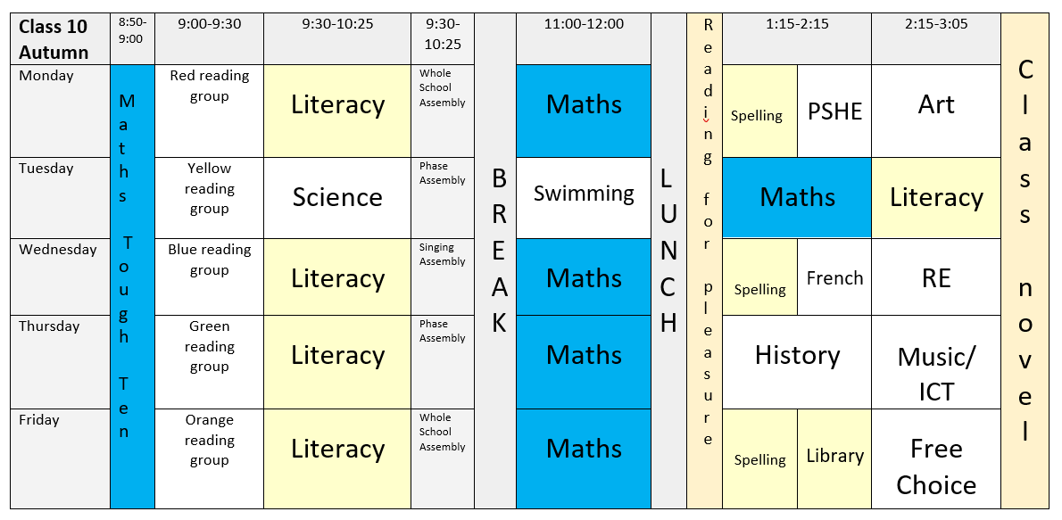
Curriculum - Example of a Weekly Timetable

Slide 15
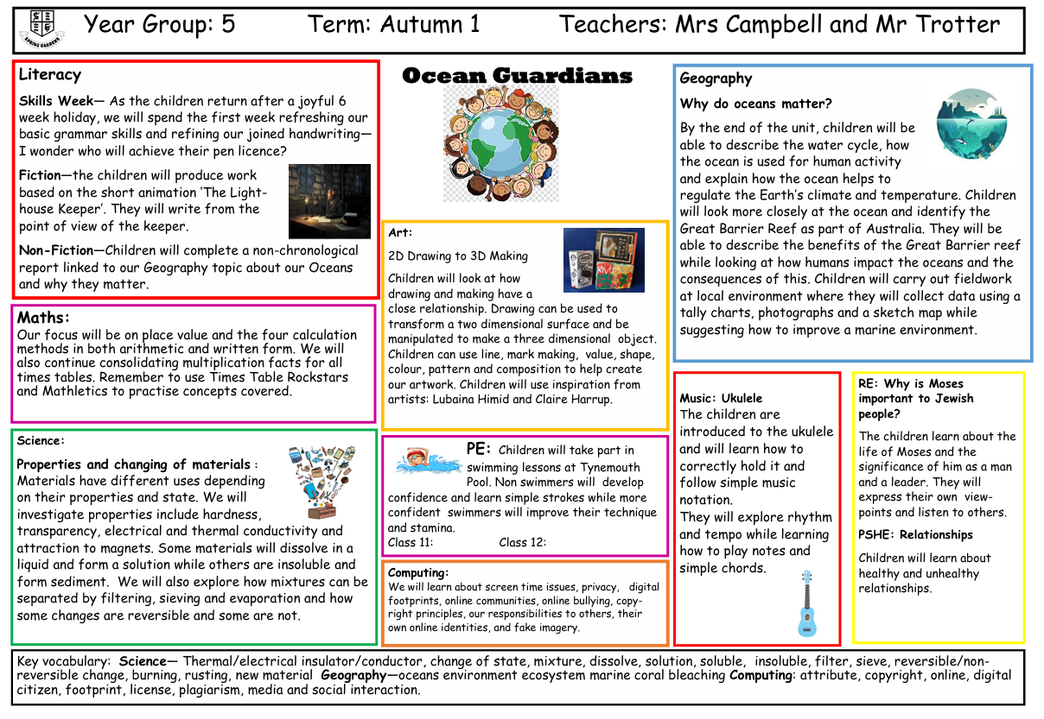
Curriculum - Example of a Curriculum Overview

Slide 16

Curriculum - Phonics & Spelling Sessions
The main strategy we use is to break words down into their syllables to help with spelling. It is important that children learn the common/high frequency words that we send home at the start of the year to support them in writing/spelling.

Slide 17
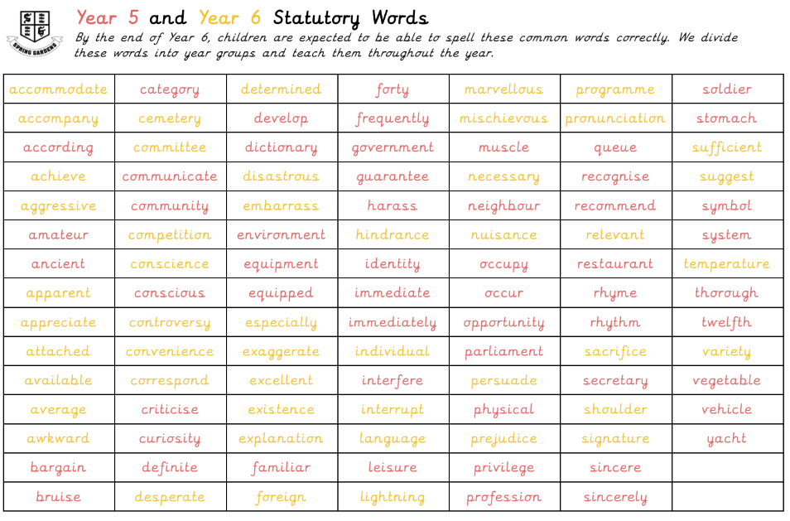

Curriculum – Literacy.
How do we teach spelling at Spring Gardens?
Notes:
Spellings taught with a dictation session at the end of the week. Not just spelling focus tested but punctuation and other common and statutory spellings. Common spellings will be focused upon within dictation each week. Writing expectations for end of the Key Stage: handwriting, basic punctuation and spelling.
Statutory Words and ‘Commonly Misspelt Words’ stuck in the back of the Literacy Homework book, along with a poster suggesting ways to practise spellings Chn can practise these at their leisure in the back of their Lit Homework book.
Spellings on school website too - year group page.
Reading book mark will be used to reward completion of homework tasks nd alternate between spelling and mathletic tasks.

Slide 18
Curriculum - Homework
Thank you for your support!
Literacy Homework
School Reading Book - regular reading aloud please.
Please look after our school reading books. There will be a £5 replacement charge for missing books.
Reading Homework - each week - linked to the book your child is reading. Every time the children do their homework, they will gain a mark on their ‘Reading Bookmark’. The children will earn a special treat at the end of the half-term for completing their bookmark.
Spellings - Statutory Words and Commonly Misspelt Words
At the beginning of the year, spellings will be stuck in the back of your child’s Literacy Homework book, along with fun ideas for how to practise them at home. The children can practise their spellings in the back of their homework book.
Maths Homework
Times Tables - each half-term we will learn a different times table in school. Please support your child with practising their tables at home too.

Slide 19

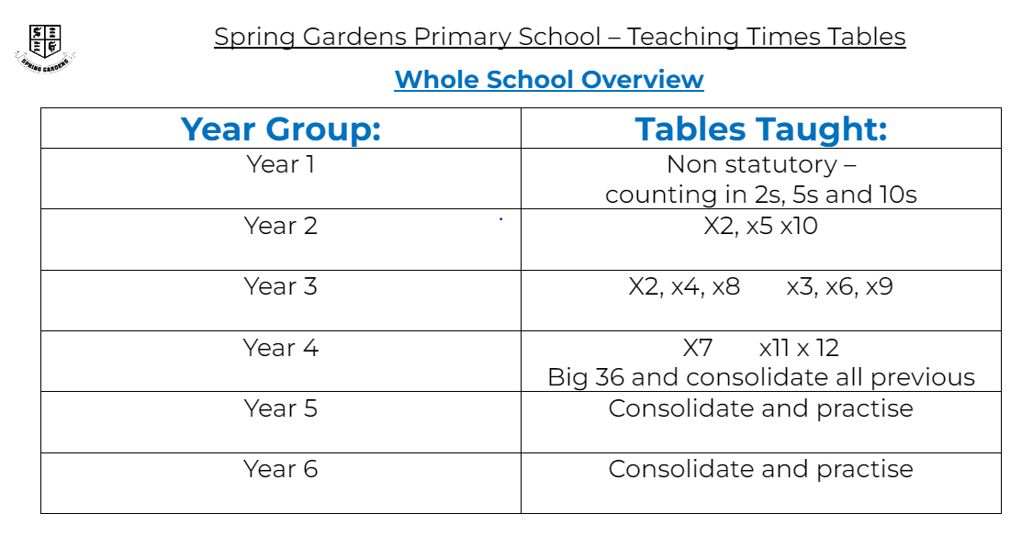
Curriculum - Maths

Slide 20

Home-School Agreement
On Monday, we will send home a copy of our Home – School Agreement. Please read through with your child and sign and return to school.
We believe this to be an important agreement as it not only sets out what school requests from parents/carers but also what you can expect from school.

Slide 21

Any questions?

